Slide 1
e-Prelude.com
Technical Data Management
Bills of Materials

Slide 2
Bills of Materials
Content
BOM types
Intermediate Level Creation
Phantom Items
Common BOM
Link Offset
BOM evolution
By-products and co-products
BOM Variants
Linking components to routing operation

Slide 3
BOM decimals
For each item, the number of decimals used for the coefficient of its BOM links should be specified
Examples:
Assembled product: 0 decimal
Only an integer number of components can be mounted
chemical combination: 4 decimals
0.0253 kg for a component

Slide 4
Which components should be recorded in the BOMs?
Should be recorded in the bills of materials
all materials and all components
including waste packaging
Should NOT be recorded in the bills of materials
components with erratic consumption and/or with a very low cost
examples: oil, stretch films, tags
recyclable packaging
examples: containers, pallets, ...

Slide 5
BOM types
Engineering BOM
created by the Product engineering department
Used during product design phases and development (up to prototyping)
Manufacturing BOM
created by the Process engineering department
maintained by the plants
Budget (or Frozen) BOM
Used as budget reference
Created by the Frozen Data Creation function (Costing menu)
Select the date for link selection
Creates a copy of valid links

Slide 6
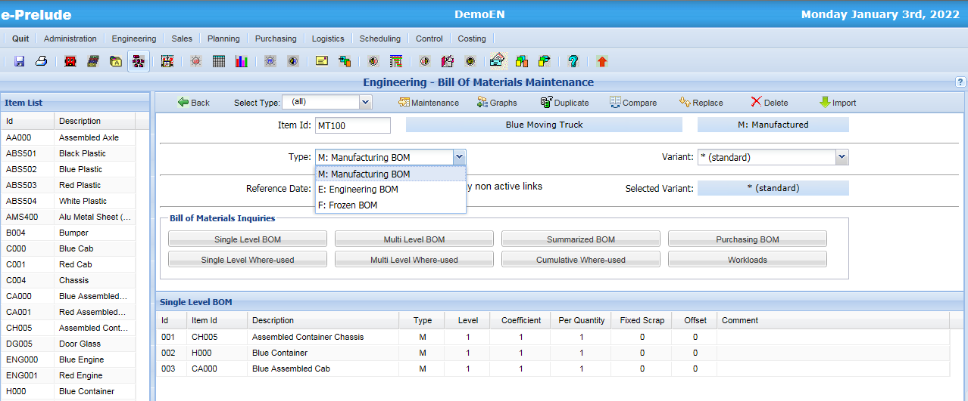
BOM types
An manufactured item can have several BOMs
Select the BOM type in the drop-down list

Slide 7
Engineering BOM
Structure depends on Product engineering department working methods
Product Breakdown usually by functions
Gradual development
Choices technical performance - manufacturing cost
Transfer to manufacturing

Slide 8
Manufacturing BOM
Structure depends on the manufacturing steps of a product
Created by the Process engineering department when it enters the routings
It must be verified that, at the lowest level, all the components entered by the Product engineering department are found in the manufacturing BOM

Slide 9
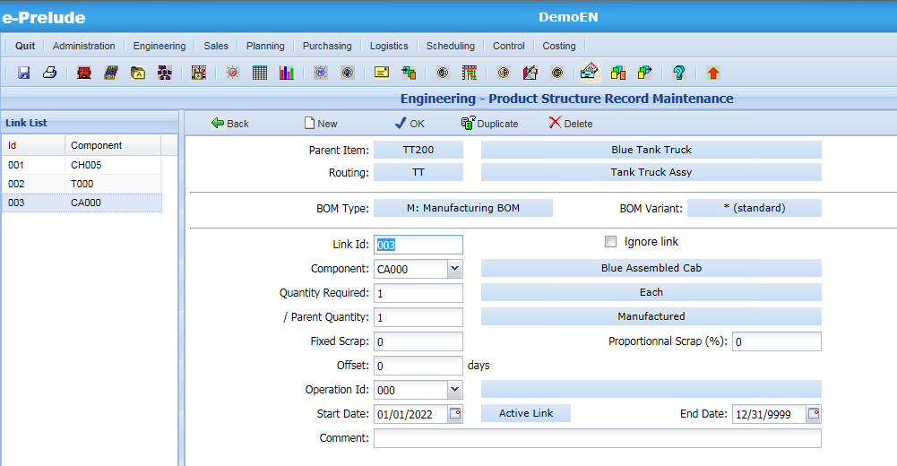
BOM Links
New fields

Slide 10
Creating an intermediate level
?
FG
FG
C1
C2
C3
S/A
C3
C1
C2
Advantages of creating an intermediate level: 1 – easier description of planning rules 2 – managing an inventory is easier than managing a WIP
3 – assembly which can be common to several parent items
Disadvantages: have to manage an additional item

Slide 11
Rules for creating a BOM level
Rules:
1 - minimize the number of levels
2 - create a sub-assembly only if inventory can exist
3 - create a sub-assembly if there is a break in the production stream
4 - create a sub-assembly if there is an independent demand (external requirements)
Practice:
Do not create a BOM level when the assembly operation is carried out as a result of the preceding operation (in the stream)
Create a BOM level at each declared manufacturing step

Slide 12
Effects of an intermediate level
P1
SA1
Allows to grouper requirements for common sub-assemblies
Receipt-Issue Transactions
Longer manufacturing cycle
FG
P2
SA2
P3
Manufacturing Cycle
P1
P2
FG
“Rake” BOM
(single level)
P3
Manufacturing Cycle

Slide 13
Phantom Items
Definition
Non-storable items (ephemeral existence)
Have a BOM
Do not have a routing
Cannot support sales forecast, Customer orders, Work orders…
Examples of use
Structuring complex BOMs
Grouping of components common to several BOMs
Creation of common BOMs

Slide 14
Common BOM
Principle:
Two products having exactly the same components can and must use a common BOM
Any change will concern both products
Example:
Two parts, left and right are made with one kg of material M
A change (ex: using only 0,9 kg of M) will automatically concern both parts
Practice:
Create a phantom item to support the common BOM

Slide 15
Common BOM
FG1
FG2
C1
C2
C3
C1
C2
C3
FG1
FG2
Phantom
Phantom
Phantom
C1
C2
C3

Slide 16
Packaging BOM
Packaging is indicated in a link with the finished product
The coefficient represents the "fraction" of packaging used by a finished product
Example: if you put 12 parts in a carton, the coefficient will be 1/12 (that is 0.0833)

Slide 17
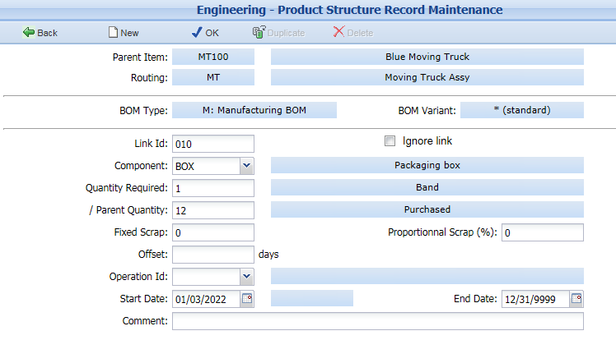
Packaging BOM
Quantity
of parent items
in the quantity of components specified by the coefficient

Slide 18
Link Offset
Object:
modify the requirement date calculated from the item lead time for some components in the BOM
Negative Offset
Makes it possible to introduce a safety lead time for a particularly sensitive component
Positive Offset
Allows to indicate that a component if not required at the release date but at the end of the process (example: packaging)
Specified in days

Slide 19
Link Offset
Work Order Release Date
Work Order Due Date
Item Lead Time
Normal required component date (offset 0)
Negative offset
Required component date with a negative offset
Positive offset
Required component date of a component used at the end of the process
Another solution: Attaching components at each routing operation

Slide 20
BOMs changes over time
Object:
Plan for future product developments (Engineering changes)
Find the composition of a product manufactured in the past (After sales)
Practice:
Changes are identified by
Validity start and end dates in product structure record
Serial numbers or Engineering change notice (not supported by e-Prelude)

Slide 21
BOMs changes over time
Changes are identifies by validity dates on product structure records Used in the MRP process at release date
FG
Link valid till March 21st
Link valid from March 22nd
C1
C21
C22
FG
FG
C1
C21
C1
C22
BOM till March 21st
BOM from March 22nd

Slide 22
Mass Replacement
A component can be automatically replaced by another
In all its where-used parent items
From an effective date
Example:
Replacing a purchased component

Slide 23
Options and Variants
Definition:
an option, it is one or several additional components
a variant, it is one or several different components
Object:
Describe slightly different products without having to completely rewrite the BOMs

Slide 24
Options and Variants
Method base + options
Phantom items grouping common components
Method base + variance
Create as many finished products as combinations of options / variants
These methods can only be used at the higher BOM level
Link selection
All the possible links are entered Valid links are selected using the value of an attribute
(not implemented in e-Prelude)

Slide 25
Method Base + options
FG220
FG110
Base
Conv220
Base
Conv110
FG optional component
FG optional component
All common components

Slide 26
Method Base + variance
Base item
FG220
C2
C1
Conv220
Base item variant
FG110
FG220
Conv220
Conv110
(-1)
(+1)
C2
C1
Conv220

Slide 27
Selection of records
Generic item
FG
C2
C1
Conv220
Conv110
On each record: a selection attribute
Attr
FG-220
220
FG-110
110
FG
Variant 220
FG
Variant 110
Conv220
Conv110

Slide 28
By-product or co-product
Object:
Describe the fact that a by-product is created when the main product is manufactured
Method:
crate the by-product as a component
Enter a negative coefficient on the record
Example:
When planning 1000 products - a need for 2500 is created on the material - a negative requirement of 1000 is created on the by-product which gives rise to an inventory receipt
Produit
Coef. : 2,5
Coef. : -1
Material
By-product

Slide 29
BOM Variants
A parent item has necessarily at least one Manufacturing BOM (M)
Used in the MRP process
You can create one or more variants of M BOMs
Can be used to update requirements of a planned order
Select a name in the variant list table (Engineering menu)
A BOM variant is linked to a routing
Examples
A component is purchased instead of being manufactured
Temporary transfer of work load to a contractor

Slide 30
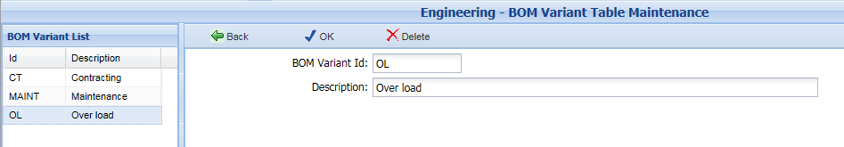
BOM Variants
Method
Create BOM Variant Table (menu Engineering, option BOM Variant Table)
Create for each variant, the item BOM (Bill of Materials Maintenance page)
Assign a BOM variant to Item routings (Item Maintenance page, Routing grid)
The planning process will take into account the item release routing and the BOM variant attached

Slide 31
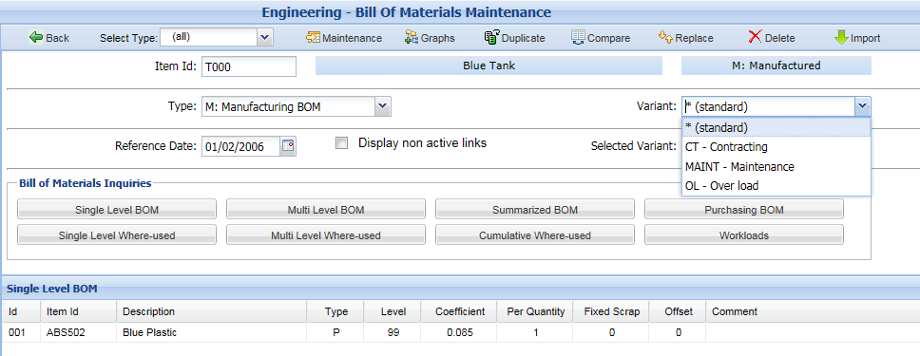
BOM Variant Selection

Slide 32
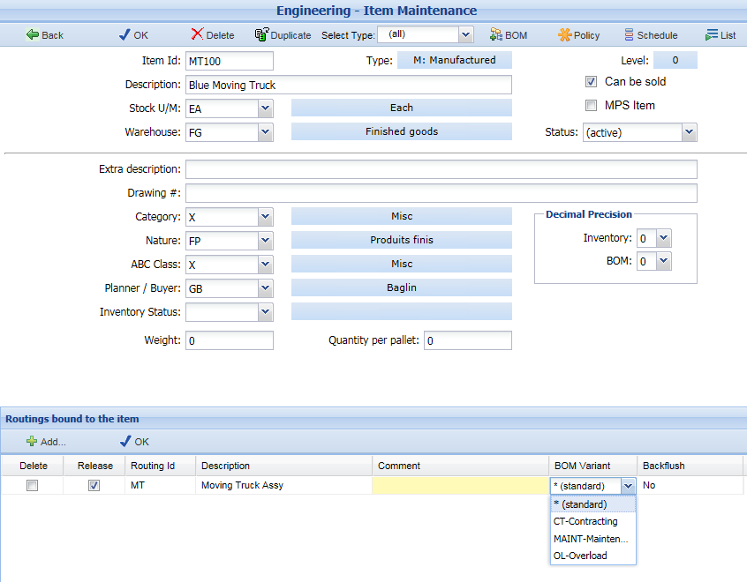
Specifying BOM Variants
For each routing, it is possible to attach a BOM variant

Slide 33
BOM Variants (another solution)
Create Phantom items as parent items
Create BOM variants for each Phantom item
Attach one of these phantom items to the manufactured item
permanently (BOM of manufactured item)
temporarily (for one work order)

Slide 34
BOM Variants (another solution)
Manufactured item
Variant 1
Phantoms
Variant 2
C1
C2
C3
A1
C2
C’3

Slide 35
Attaching components to each operation
Manufacturing routing
Op. 010
Op. 020
Op. 030
Op. 040
Material 1
S / A
Manufactured Item
Material 2
It is indicated to which routing operation the component is used
This information is used for
Planning components requirements
Components backflush at each operation

Slide 36
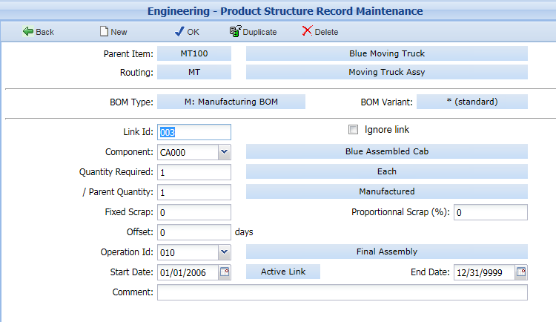
Attaching components to each operation
Nouvelle zone

Slide 37
Attaching components to each operation
WO Release Date
WO Due Date
Op. 010
Op. 020
Op. 030
Op. 040
Due date
for components
attached
to operation 010
and components
Not attached
to any operation
Due date
for components
attached
to operation 020
Due date
for components
attached
to operation 030
Due date
for components
attached
to operation 040
Components Due Dates
are calculated while scheduling the Work Order

Slide 38
Effects on Production Cycle
P1
S/A1
FG
P2
S/A2
P3
Production Cycle
S/A1
P1
FG
P2
P3
S/A2
Production Cycle

