Slide 1
e-Prelude.com
Technical Data Management
Items

Slide 2
Item Management
Content
Codification
Item attributes
Stock unit of measure and purchasing unit of measure
Phantom Items
Non stocked items

Slide 3
Which Items should be recorded?
Finished goods
Sub-assembly or intermediate products
Manufactured or sub-contracted
Purchased goods
Raw materials et components
Trade goods
Purchased and sold without any transformation
Packaging
boxes, ...

Slide 4
Items involved
Purchased goods
Raw materials and components
Sub-assemblies
manufactured or sub-contracted
Finished goods
Trade goods
Purchased and sold
Packaging
boxes, ...

Slide 5
Item codification
Mnemonic Codification
Advantage: easy to identify the item
Disadvantage: required to create long, complex and difficult to maintain codes
Often involves alpha codes
Example
SWHC0530 (wood screw, countersunk head, diameter 5 mm, length 30 mm)

Slide 6
Item codification
Arbitrary Codification (numeric)
Advantage: short codes, easy to enter, no classification problem
Disadvantage: requires to keep lists to find the item
Example
31822045

Slide 7
Item codification
Mnemonic Root (family, nature or category) + a chronological sequence
Advantage: it is easy to identify the item nature
Example
T FFF nnnn
Type
Family
Sequence Number
Examples of types:
1 : Raw materials, 2 : Purchased components, 3 : Consumables
4 : Sub-contracted items, 5 : Manufactured items, 6 : Phantom items, ...

Slide 8
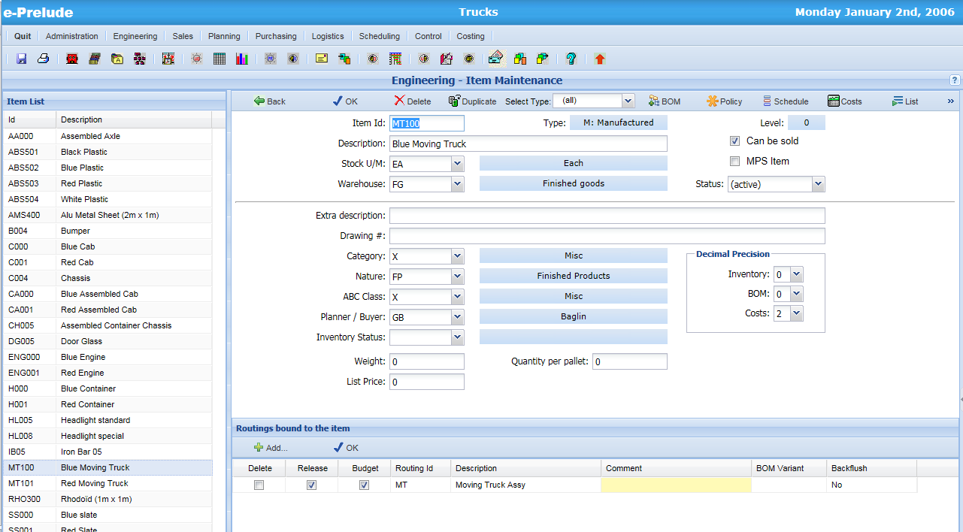
Item Maintenance
Additionnal
Information fields

Slide 9
Item Attribute Tables
Engineering Menu
Item Status
Unit of measure
Item Category
Item Nature
ABC Class
Planner
Logistics Menu
Inventory Status
Warehouse

Slide 10
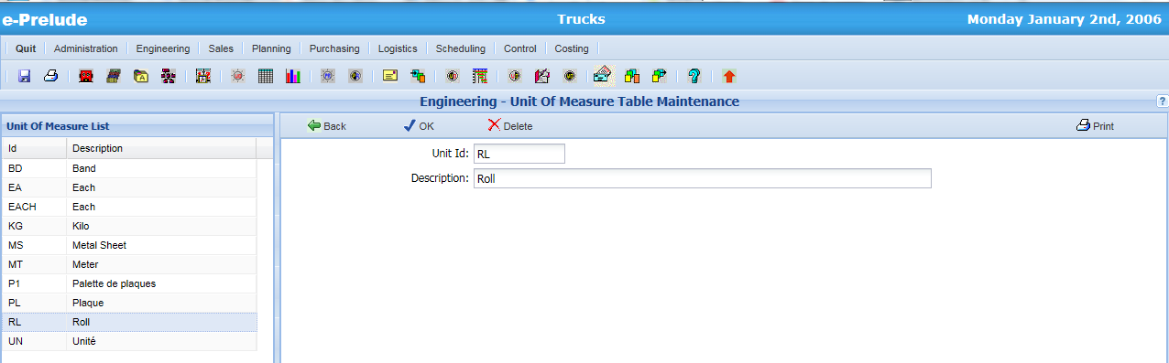
Attribute Table Maintenance
Select the table to update :
Enter the code then the description. Validate with OK
Note: Accounting information are entered in the Item Category Table

Slide 11
Item status
Characterize item during its life cycle
Activated
Prototype
Pre-serie
Accepted
Serie
Fin de vie
Obsolete
Desactiv.
Each status can correspond to a number of locks
Life stages are reversible
Some life stages can be skipped
Item status are not managed by e-Prelude

Slide 12
Units of measure
The unit of measurement describes the unit in which the item is managed within the company
examples: part, pound, meter, …
We also specify the number of decimals in the stock management according to the desired precision
0 : 25 kg
3 : 1.253 kg

Slide 13
Warehouses
Access: Logistics Menu, Warehouse Table Maintenance Option
Physical Warehouses
Geographical locations in which items can be stored
examples:
RM: Raw material warehouse
SF: Semi-finished products warehouse
FG: Finished goods warehouse
Inventory reports per warehouse

Slide 14
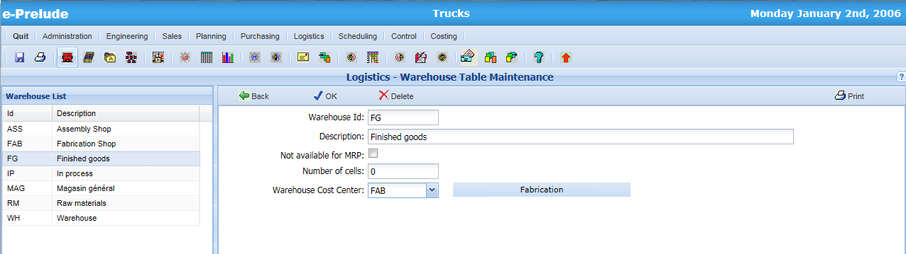
Warehouse available for MRP or not
Indicates the warehouse capacity
Specifies if the inventories in this warehouse can be taken into account by the MRP function

Slide 15
Item categories and natures
Categories
Grouping of items by commercial families
linked to general ledger
Natures
Grouping on physical or technical characteristics
ex: plastic parts, screws...

Slide 16
ABC classes
Characterize the economic importance of each item
Classification according to consumption value
Relations to Reorder Policy

Slide 17
Planners / Buyers
Agent in charge of managing the supply of the item
Purchased Item: it is the buyer
Manufactured Item: it is the planner
Specific reports per buyer / planner

Slide 18
Inventory status
The notion of inventory status is described in the Inventory Management presentation
For each item, it is the default status for inventory transactions
example: a purchased item has to be inspected before it can be used by the workshop -> default status : INSP

Slide 19
Item weight
Item weight in its unit of measure
Allows to plan packaging and transportation
Automatic calculation of the weight of a parent item with the weight of its components by the cost roll-up function

Slide 20
Item Volume
The item volume is described as the number of units which can be stored on a pallet
Allows to calculate
The volume of flows of goods (in number of pallets to ship and to receive)
The warehouse capacity utilization

Slide 21
Stocking unit and purchasing unit
The unit in which a product is purchased may be different from the unit in which the product is managed internally
example: 10 m sheet strips are purchased and managed in meters
We specify a conversion coefficient between units (ex: 10)
Different suppliers of the same item may have different purchasing units

Slide 22
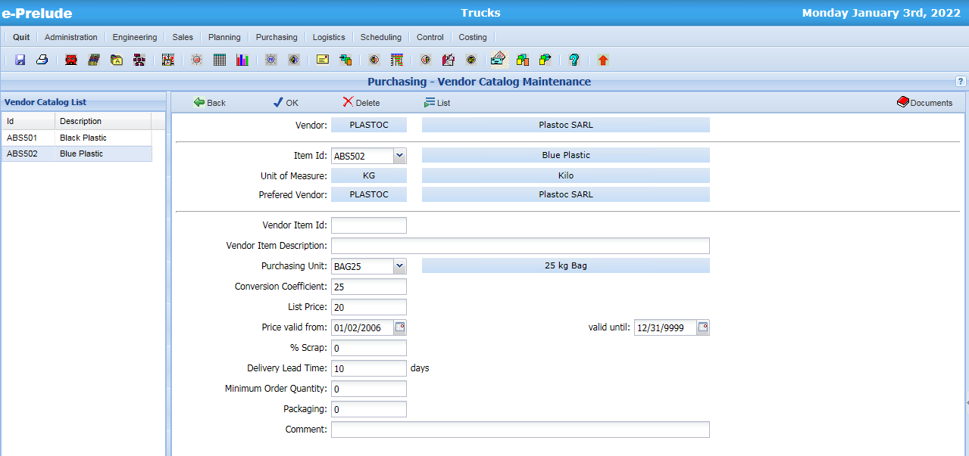
Stock unit and purchasing unit
Stock unit of measure
(item window)
Purchasing unit and
conversion coefficient

Slide 23
Packaging
This is the vendor's multiple sales unit
example: Pallets of 8 drums
We will have to order a multiple of the packaging quantity

Slide 24
Phantom Items
Allows to structure the BOMs
Allows to create common BOMs
Can not give rise to work orders and cannot be stored
Are "transparent" in the requirements calculation procedure
They will be treated in the slideshow on the BOM management

Slide 25
Non-stocked Items
Articles which cannot be physically stored
Do not have BOM or manufacturing routing
Can be used in BOMs to indicate material or intangible elements used in the item valuation
examples: oil, rags, paper, screws…
Can also be used to invoice services or labor
Hours of maintenance
Packaging
Not to be confused with the Item reorder policy "Not managed"

Slide 26
Item Management Parameters
Will be described in the presentation about production planning

