Slide 1
e-Prelude.com
Tour - session 0
Starting Application

Slide 2
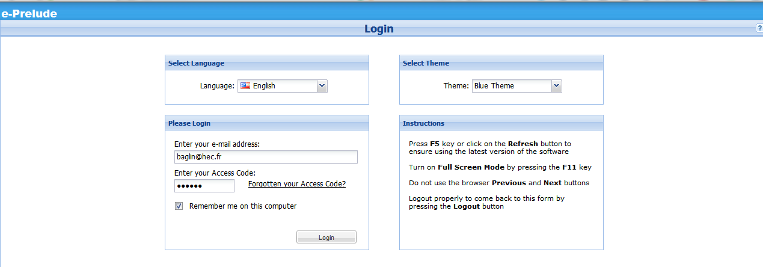
e-Prelude Application Login Page
On any Site Page, click on Enter Application
You reach the Login Page
Re-enter your e-mail address and access code if you have not ticked the ‘Remember me’ check box
Click on Login
Login

Slide 3
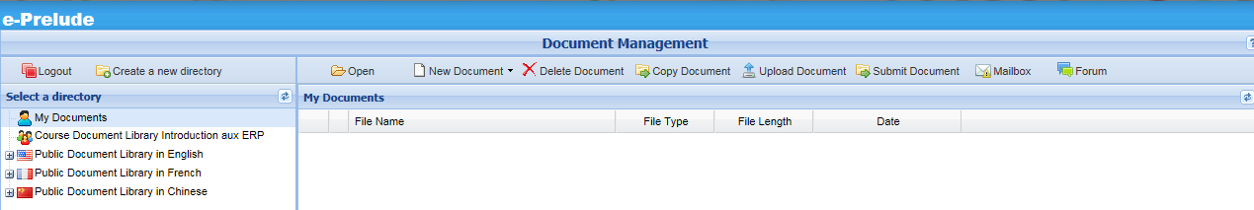
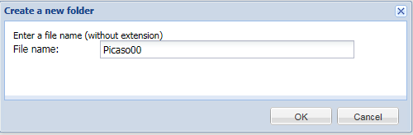
Creating a new folder
Click on the New Document button
and select Folder
Enter ‘Picaso00’ and validate by OK

Slide 4
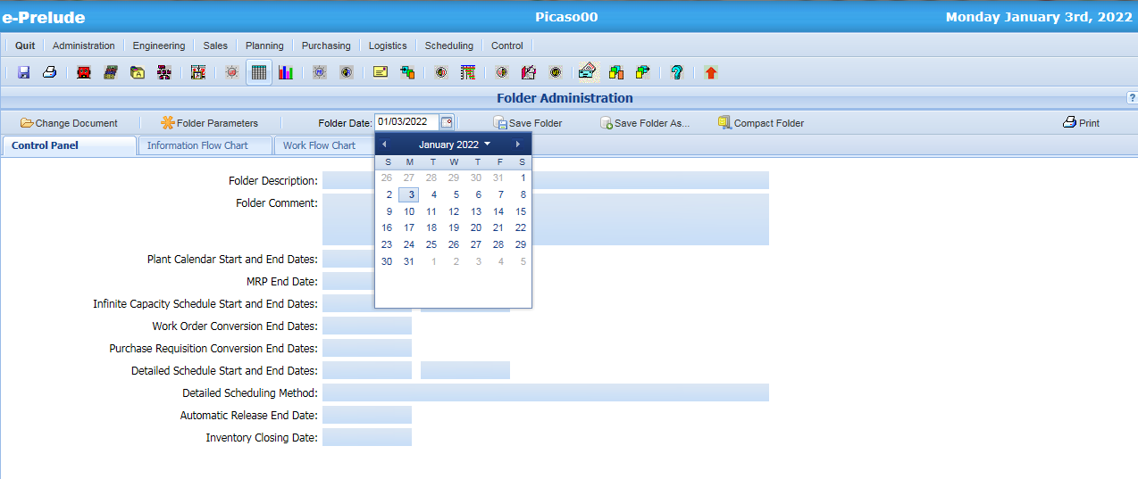
The Administration page
Click here to change the date
Select
the date
Monday January 3rd, 2022

Slide 5
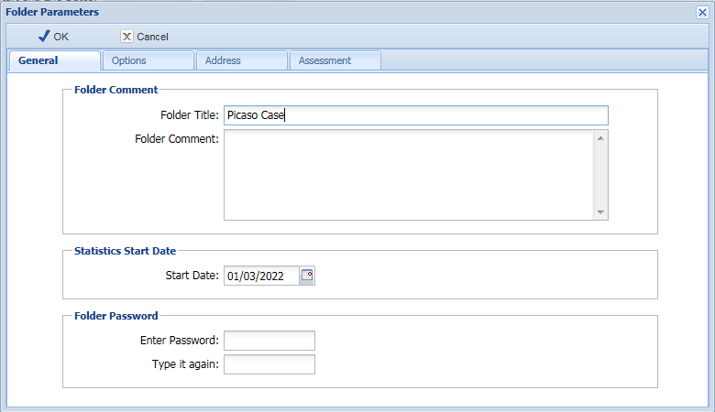
Changing Folder Parameters
Enter a title for the folder
Select the Basic level
Tick the box
AR & AP

Slide 6
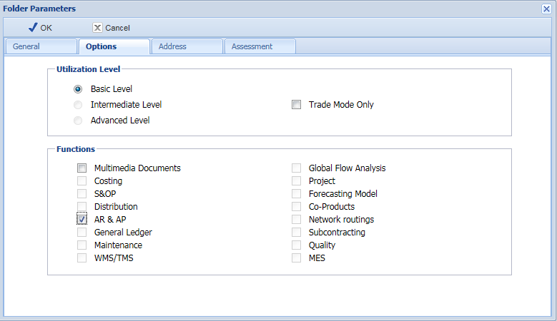
Changing Folder Parameters
Select Options tab
Select the Basic level
Validate by OK
Tick the box
AR & AP

Slide 7
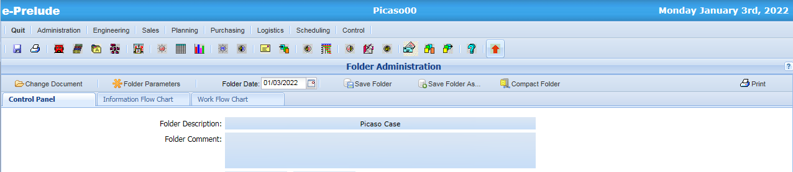
Archiving the folder
Archive the folder by clicking on the Save Folder button

Slide 8
End of session 0

