Slide 1
e-Prelude.com
Tour - session 1
Items Maintenance

Slide 2
Software Information Chart
S1
Items
S&OP
Forecast
S2
S5
BOM
Master Production Schedule
Technical
Data
Orders
S6
Resources
MRP
Inventory
S4
S3
Routings
Shipments
Production Orders
Requisition Orders
S8
S10
Costing
Scheduling Order Release
Procurement
General Ledger
Production Activity Control
Receipt
S9
S7
Notes:
A gauche en jaune, le bloc de gestion des données techniques
Cliquer sur un pavé pour accéder directement à la diapo détaillée
Des boutons RETOUR figurent sur ces diapo pour revenir ici.

Slide 3
Item Definition
Items represent all the materials of which you want to manage flows and inventories
They can be purchased or manufactured

Slide 4
Item creation process
Enter required data into codification tables
Unit of measure table is already filled with UN : Each
Create the vendor
Enter items characteristics
For purchased items, select the vendor

Slide 5
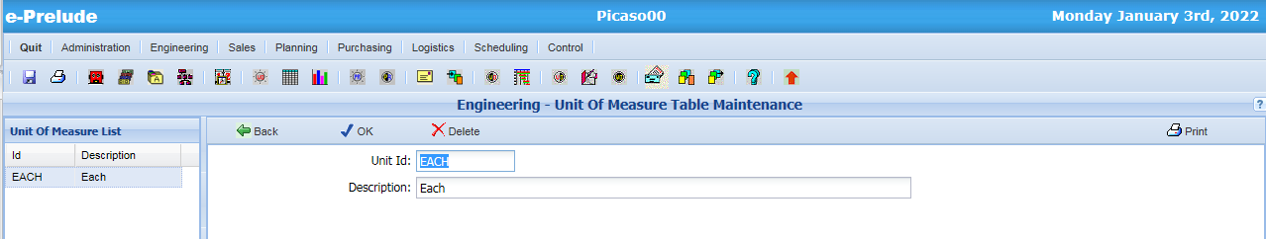
Table Maintenance
Access: Engineering Menu, Unit of Measure Table Maintenance Option

Slide 6
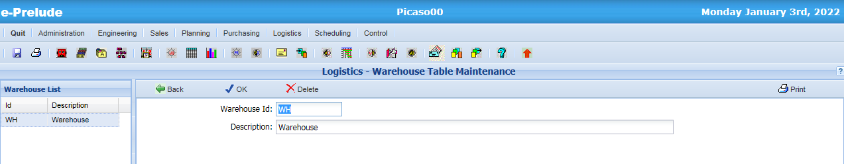
Warehouse Table
Access: Logistics Menu, Warehouse Table Maintenance Option

Slide 7
Accounts Receivable and Accounts Payable functions
The Accounts Receivable and Accounts Payable functions require additional information located in four tables:
VAT Rate Table (AR&AP menu)
Payment Term Table (AR&AP menu)
Payment Mode Table (AR&AP menu)
Item Category Table (Engineering menu)

Slide 8
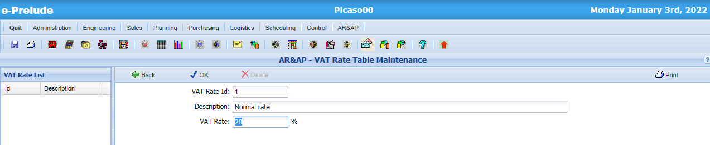
VAT Rate Table
Access: AR&AP Menu, VAT Rate Table Maintenance Option
1. Enter a VAT code (‘2’ for example)
then a description
3. Validate
2. Enter the VAT rate (’20’ for example)

Slide 9
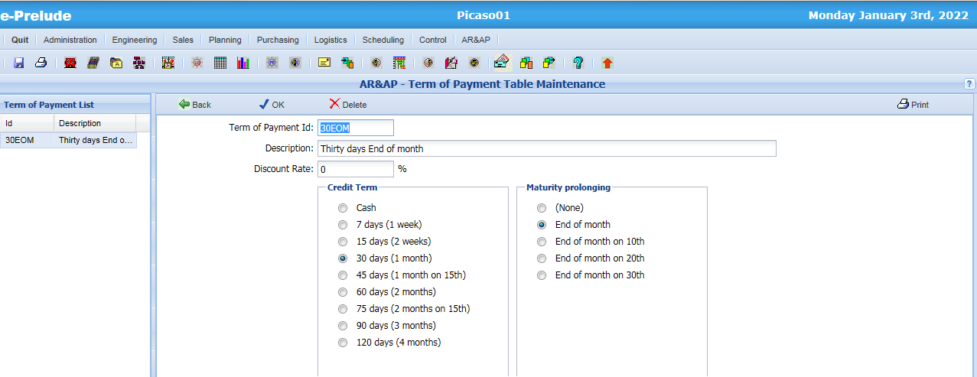
Terms of Payment Table
Access: AR&AP Menu, Term of Payment Table Maintenance Option
1. Enter the code ’30EOM’
the a description
3. Validate
2. Select options
- 30 days
- End of Month

Slide 10
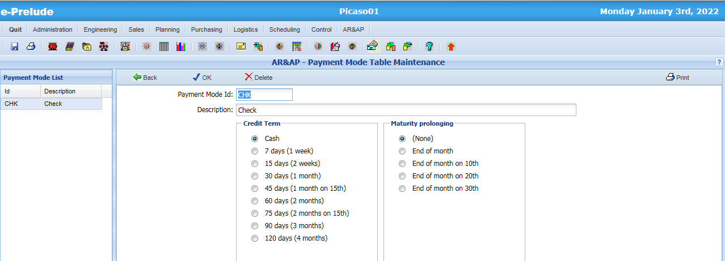
Payment Mode Table
Access: AR&AP Menu, Payment Mode Table Maintenance Option
1. Enter the code ‘CHK’
then a description ‘Check’
3. Validate
2. Select options
- Cash
- None

Slide 11
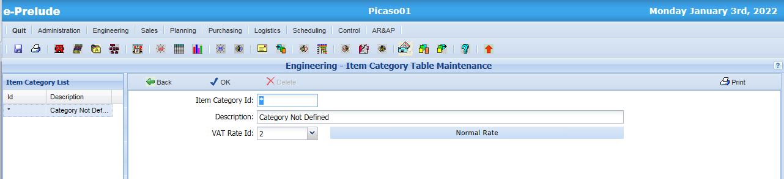
Item Category Table
Access: Engineering Menu, Item Category Table Maintenance Option
Was created at folder creation

Slide 12
Item types
Two Item types depending on their source
Manufactured items
They will have a routing
Purchased items
They will have a preferred vendor
To create an item, its type must be selected first (the item type cannot be changed later)
Note: there other item types which will be discussed later

Slide 13
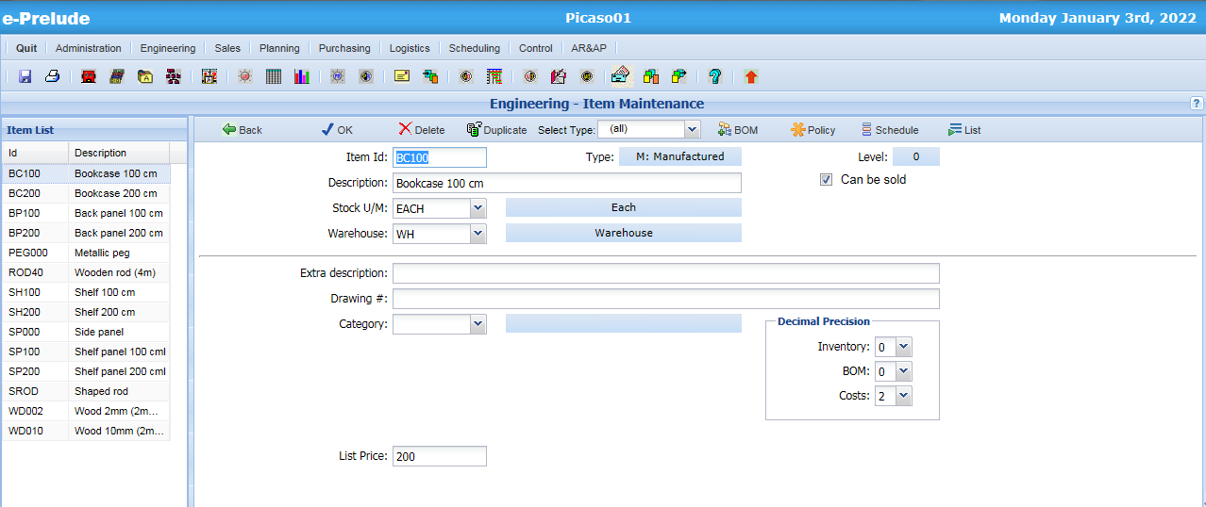
Creating Items
Access: Engineering Menu, Item Table Maintenance Option
6. Validate
1- Select the
item type
2- Enter item code
and its description
3- Enter
Unit of measure
and warehouse codes
4- Other optional information
5- Enter Selling price

Slide 14
Item Management parameters
Reorder policy and Lot sizing rule define the way the item will be planned
The Lead Time specifies the number of days normally required to get items
from a vendor (purchased items)
from the plant (manufactured items)

Slide 15
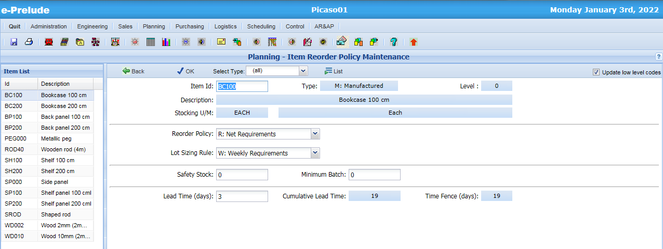
Creating Items
Access: Planning Menu, Item Reorder Policy Option
1- Select
the reorder policy
in the drop-down list
4-Validate
2- Select
the lot sizing rule
3- Enter
the lead time

Slide 16
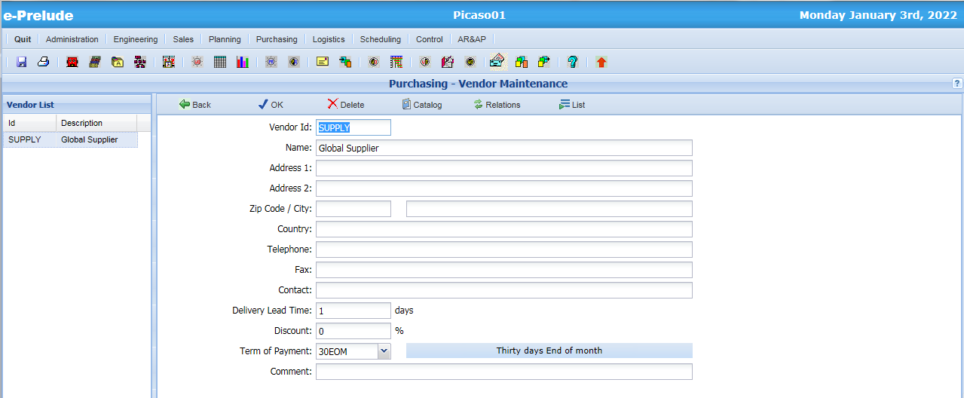
Vendor Entry
Access: Purchasing Menu, Vendor Maintenance Option
1. Enter its code and its name
(other fields are optional)
4. Validate
2. Enter the usual delivery lead time
5. Catalog
3. Select payment term 30EOM’

Slide 17
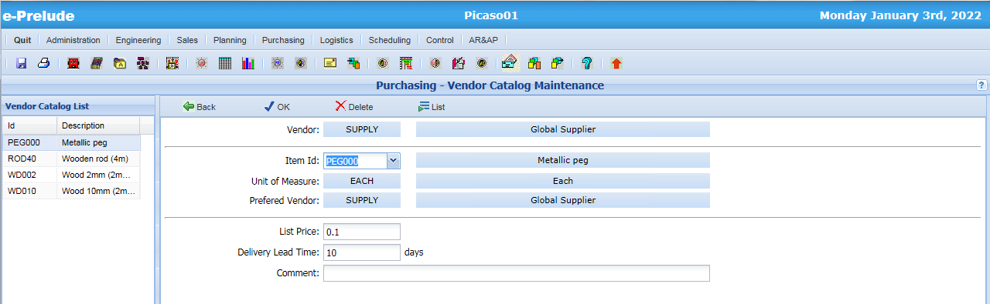
Vendor Catalog
1 – Enter Item code (or pick it in the drop-down list)
2 – Enter purchasing price
4 – Validate
3 – Enter vendor lead time for the item

Slide 18
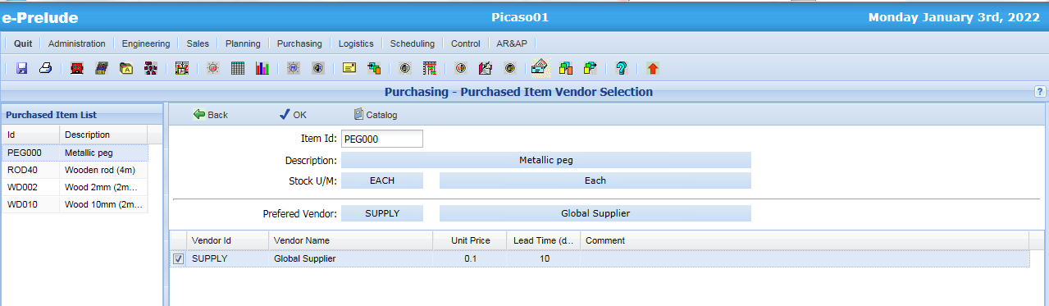
Purchased Item Vendor Selection
Access: Purchasing Menu, Purchased Item Vendor Selection Option
1 – Select Item
2 – This vendor is the
preferred vendor
for this item

Slide 19
Multiple vendors
A purchased item can be sourced from several vendors
All the vendors should be entered in the data base (with the selling price and lead time)
One vendor is selected as the preferred vendor for the item - it is the vendor on which the purchase requisitions will be automatically issued) - the item lead time is automatically set to the preferred vendor lead time

Slide 20
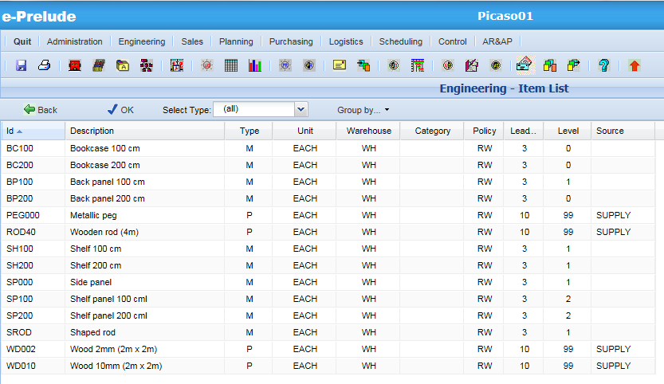
Item List
Access: Engineering Menu, Item List Option

Slide 21
End of Session 1

