Slide 1
e-Prelude.com
Tour - session 2
Bills of materials

Slide 2
Software Information Chart
S1
Items
S&OP
Forecast
S2
S5
BOM
Master Production Schedule
Technical
Data
Orders
S6
Resources
MRP
Inventory
S4
S3
Routings
Shipments
Production Orders
Requisition Orders
S8
S10
Costing
Scheduling Order Release
Procurement
General Ledger
Production Activity Control
Receipt
S9
S7
Notes:
A gauche en jaune, le bloc de gestion des données techniques
Cliquer sur un pavé pour accéder directement à la diapo détaillée
Des boutons RETOUR figurent sur ces diapo pour revenir ici.

Slide 3
Product Structure Tree
The bill of materials describes which components are used in the manufacturing of a product
Parent Item
Link
Coefficient
Specifies the number or the quantity of component in a parent item
1
2
0.5
Component A
Component B
Component C
Bills of materials are entered for each level which are related to item manufacturing steps

Slide 4
BOM Levels
Levels
0
Finished Good
1
S/A 1
S/A 2
2
Part A
Material 2
Material 3
Material 4
Part B
3
Material 1
Material 5
At lowest level, only purchased components or raw materials

Slide 5
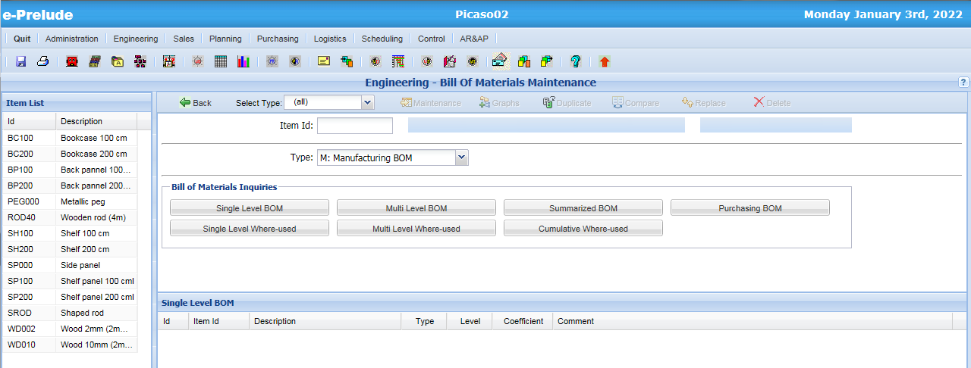
The BOM Page
Access: Engineering Menu, Bill Of Materials Maintenance Option
Parent Item List
Graphs
Management
functions
Create, modify or delete product structure links
Inquiries

Slide 6
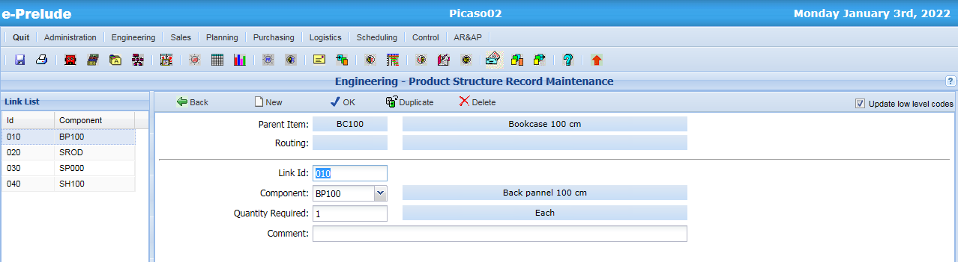
BOM Link Entry
1- Click on ‘New’
4. Validate
2- Select Component
3- Enter Quantity of
component
in one parent item

Slide 7
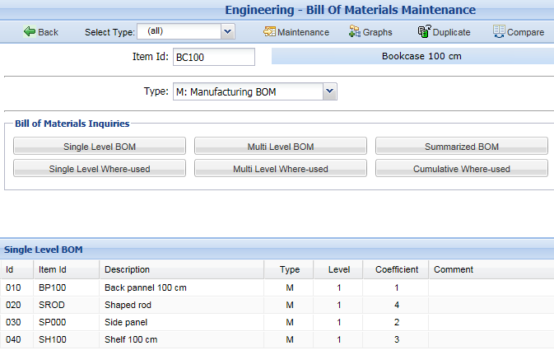
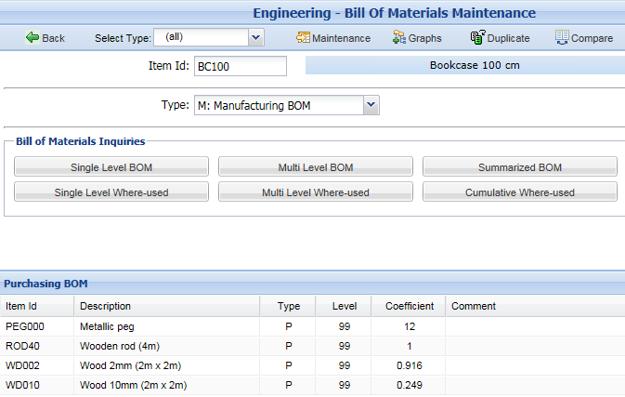
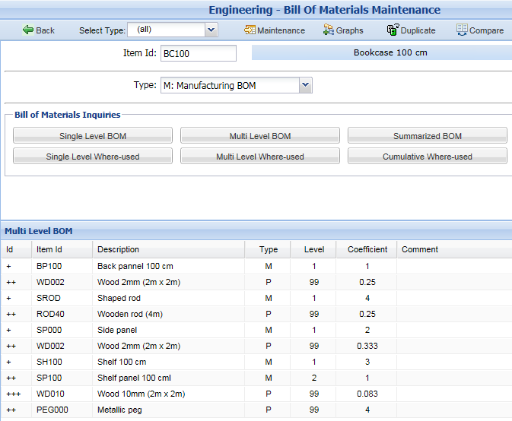
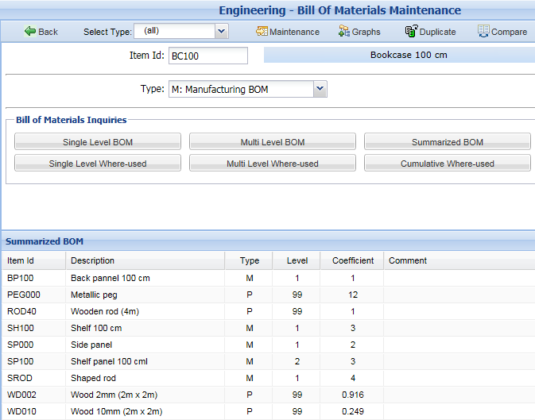
BOM Inquiries
Single level BOM
Purchase BOM
Multilevel BOM
Summarized BOM

Slide 8
Common Components
FG1
FG2
S / A
Common sub-assembly
Material 1
Component 1
The BOM of an item is described only once

Slide 9
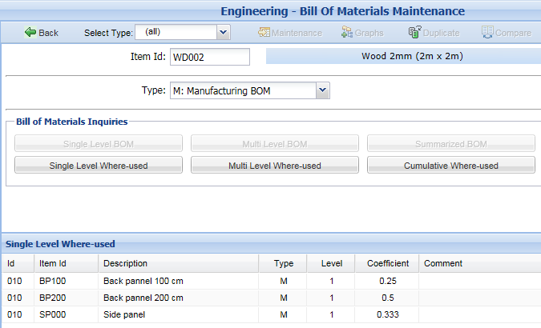
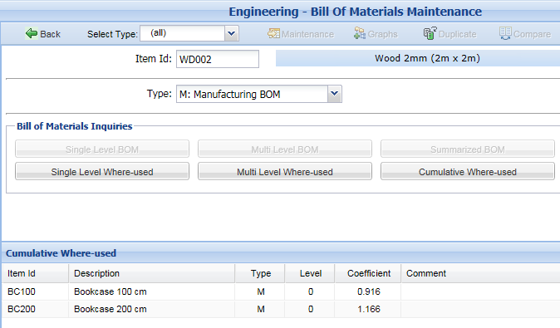
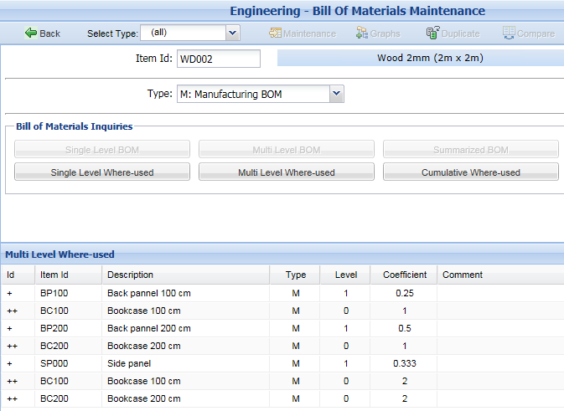
Where-used Inquiries
Single level where-used
Cumulative where-used
Multilevel where-used

Slide 10
Checking for loops in BOM
Avoid infinite loops in the processing of BOMs
Example of loop in a BOM:
Product A
Material
Component C1
Loop
Component C4
Product A

Slide 11
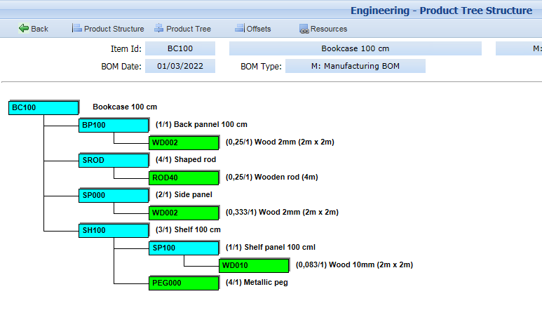
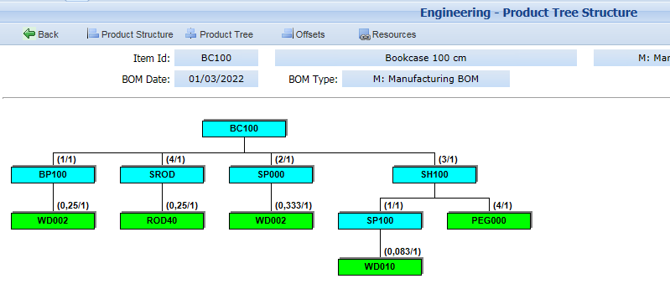
Product Tree Structure Graph

Slide 12
Low level code
Finished goods are at level 0
Level 0
FG1
FG2
Level 1
Comp. C
SA10
SA21
SA22
Level 2
Comp. C
In the BOM of FG1,
component C is at level 1
In the BOM of FG2,
component C is at level 2
Low Level Code of C is 2

Slide 13
Low level codes
It determines the lowest level of a component in all the BOMs
It calculates also the cumulative lead times
Note: Purchase items are set at level 99

Slide 14
Cumulative Lead times
Manufactured
component
Manufactured
component
Manufacturing lead time
Purchased component
Purchasing lead time
Manufacturing cumulative lead time
Total cumulative lead time

Slide 15
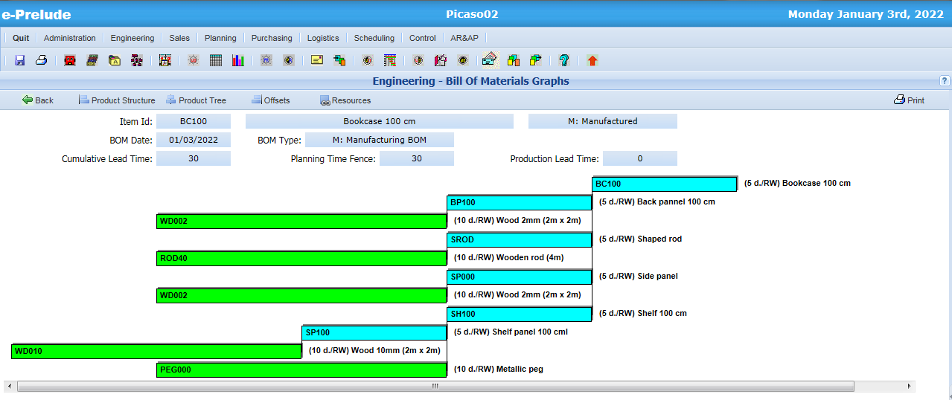
Lead Time Offset Graph

Slide 16
End of session 2

