Slide 1
e-Prelude.com
Tour - session 3
Calendars, Work Centers and Routings

Slide 2
Software Information Chart
S1
Items
S&OP
Forecast
S2
S5
BOM
Master Production Schedule
Technical
Data
Orders
S6
Resources
MRP
Inventory
S4
S3
Routings
Shipments
Production Orders
Requisition Orders
S8
S10
Costing
Scheduling Order Release
Procurement
General Ledger
Production Activity Control
Receipt
S9
S7
Notes:
A gauche en jaune, le bloc de gestion des données techniques
Cliquer sur un pavé pour accéder directement à la diapo détaillée
Des boutons RETOUR figurent sur ces diapo pour revenir ici.

Slide 3
Description of a manufacturing process
Routings describe the manufacturing process to elaborate a product with its direct components
This process requires often several steps (or operations)
For each operation, one specifies
which resource(s) is/are required
the times to complete the operation
Time to prepare the resource (set-up time or change-over time)
Run time (time to perform the operation on one single part)

Slide 4
Routings - Definition
M 1
Routing = steps of the manufacturing process
M 2
Op. 010
Op. 020
Op. 030
Op. 040
Manuf. Item
Px
S / A
Materials, components,
fabricated parts
and sub-assemblies

Slide 5
Routing usages
Computation of work load
Calculation of manufacturing costs
Production activity control
Performance Measurement

Slide 6
Routing creation process
Creation of calendars
Creation of work centers
Creation of routings
Attachment of a routing to each manufactured item

Slide 7
Work center - Definition
A Work Center is:
A group of machines or work stations
One single machine
Several machine performing the same type of operation
A manual work station
An assembly line
Its capacity is defined by a calendar

Slide 8
Work Center Types
Finite Capacity (F)
regroups one or more machines (the features of which can describe individually)
Multiple work stations (M)
Are not individually described
The number of work stations is specified in the “Capacity Coefficient” field
Infinite Capacity (I)
Its work loads are not calculated
The type of a work center cannot be changed

Slide 9
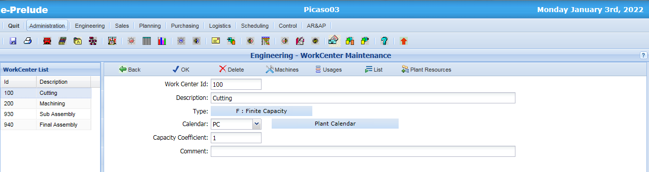
Work Center Entry
Access: Engineering menu, Work Center Maintenance option
Enter
1 – Work Center Code
2 – Description
3 – Select Type
(Type cannot be modified)
Validate with OK

Slide 10
Manufacturing routings
A routing is described with
a routing header
a set of operations for each manufacturing step

Slide 11
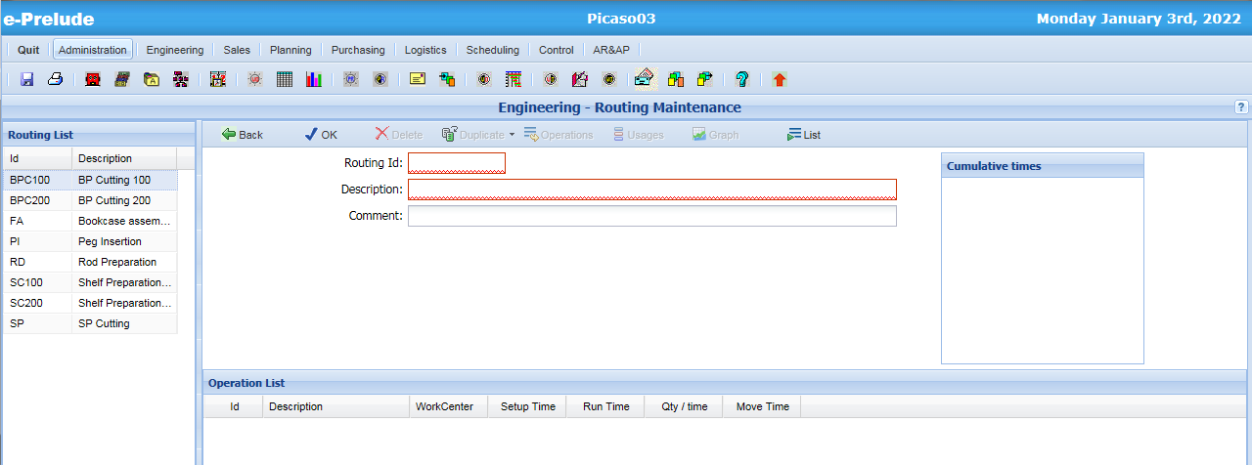
Routing Entry
Access: Technical Data menu, Routing Maintenance option
Routing Header
Enter Routing Id and Description
Call the Operation Maintenance Window (Operations button )

Slide 12
Operating times
Set up Time
Run Time
Move Time
Fixed time
(independent of the quantité processed)
Time is proportional to the quantity processed
Can be specified as a unit time or as a production rate
Fixed time to move the parts to the next operation
Induce work load on the work center
➔ All the times are given in hours (with 4 decimals)

Slide 13
Operating time definition
➔ All the times are given in hours (with 4 decimals)
Case
Run Time
Quantity per time
Time per part in hours
1.2250
1
Hourly production rate
1
230
Time per part in minutes
2.5
60
Time per part in seconds
2.5
3600
Time for a fixed quantity
3.5
2000
Daily production rate
7.5
600

Slide 14
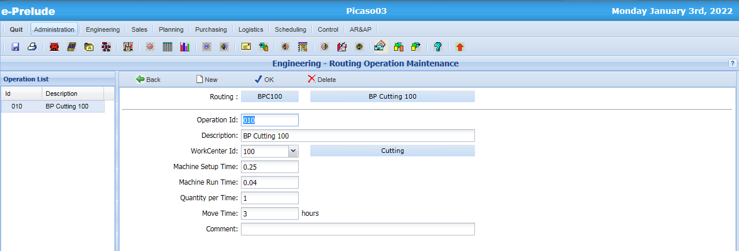
Operation Entry
Enter
1- the operation number
2- the operation description
3- the work center
4- the setup time… 5- the machine run time ... 6- ...for the quantity of parts
7- the move time
Validate with OK
Repeat for the next operations till the end of the routing and go back to the routing header window

Slide 15
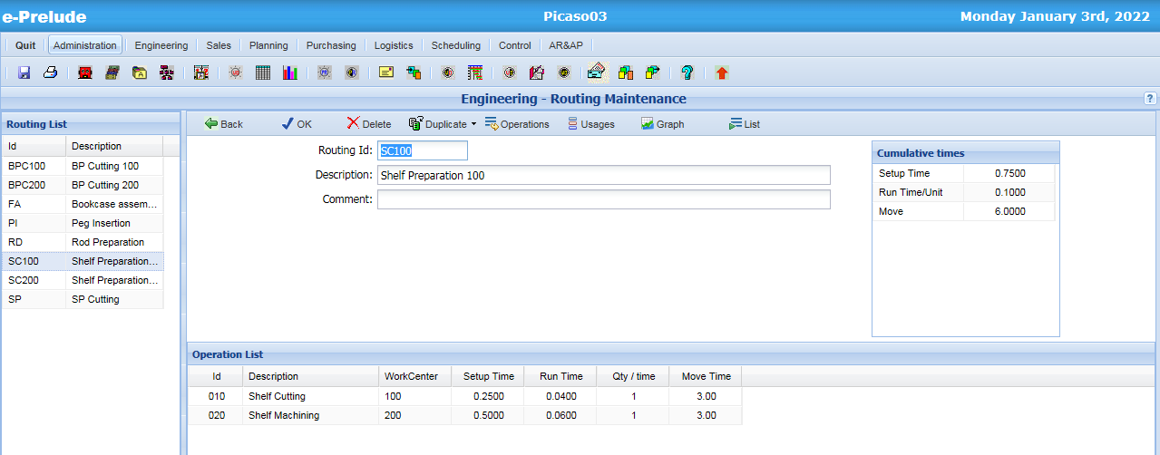
The routing window
Total times for all the operations
Operation List

Slide 16
Time totals
Work Center 1
Op. 010
Setup
Run Time
Move
Work Center 2
Op. 020
Setup
Run Time
Move
Work Center 3
Op. 030
Setup
Run Time
Move
Total manufacturing time for a batch
Setup
Run Times
Move
Independent of lot size
Proportional to lot size
Independent of lot size

Slide 17
Attachment of routing to manufactured items
Each manufactured item should have (at least) one routing
On routing should be selected as release routing
Several items can share the same routing

Slide 18
Item – Routing Attachment
Manufactured Item
A manufactured item should be linked to a routing
Routing
Op. 40
Op. 30
Op. 20
Op. 10
Operations are usually number from 10 to 10 during the creation of the routing to enable insertion of additional operation

Slide 19
Routing sharing
Item X red
Item X green
Routing
The two items have the same manufacturing process (but their BOM are different
Op. 40
Op. 30
Op. 20
Op. 10

Slide 20
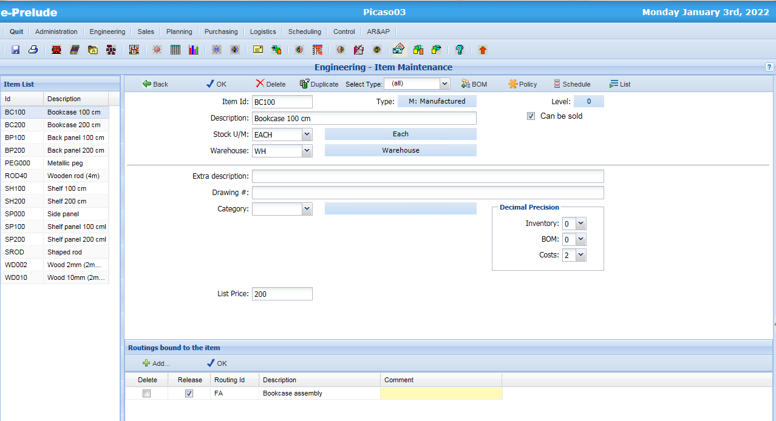
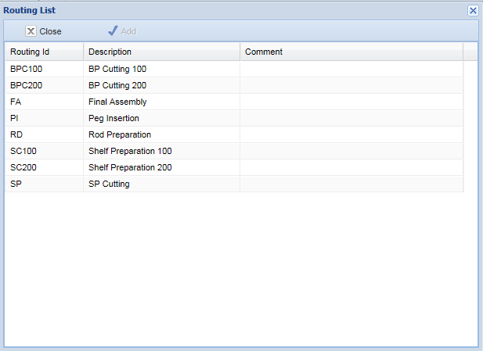
Item – Routing Attachment
1- Select the item
3- Select the a routing in the list
2- Click on
Add...
6- Validate here
4- Tick the ‘Release’ box

Slide 21
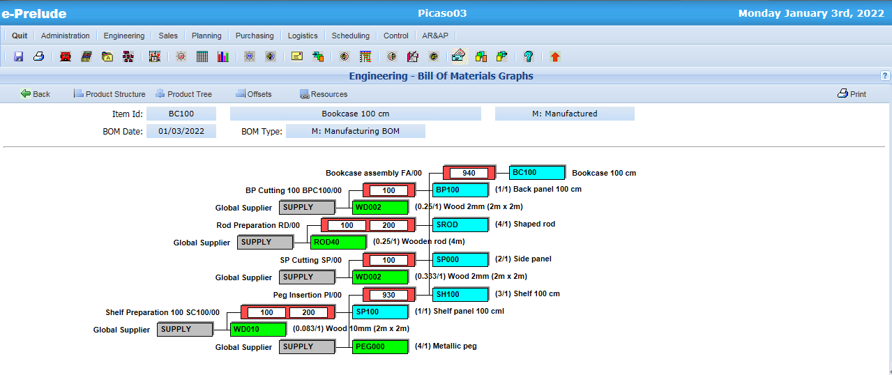
Resource graph for the manufacturing of an item
Access: Technical Data menu, Bills of materials option Graphs button, Resources button

Slide 22
End of session 3

