Slide 1
e-Prelude.com
Tour - session 4
Beginning Inventories

Slide 2
Software Information Chart
S1
Items
S&OP
Forecast
S2
S5
BOM
Master Production Schedule
Technical
Data
Orders
S6
Resources
MRP
Inventory
S4
S3
Routings
Shipments
Production Orders
Requisition Orders
S8
S10
Costing
Scheduling Order Release
Procurement
General Ledger
Production Activity Control
Receipt
S9
S7
Notes:
A gauche en jaune, le bloc de gestion des données techniques
Cliquer sur un pavé pour accéder directement à la diapo détaillée
Des boutons RETOUR figurent sur ces diapo pour revenir ici.

Slide 3
Inventory Control
All the items are stored in warehouses
  A warehouse is a physical place where goods are kept
Any change in a quantity of an item in a warehouse is made through an inventory transaction
  manual
  automatic

Slide 4
Inventory status
In a warehouse, items can have several status ; two main status:
AVAIL = good is available
RESV = reserved for production

Slide 5
Many types of inventory transactions
IN : physical inventory counting
OR : vendor order receipt
AI : issue from Available
RR : receipt into Reserved for production
RI : issue from Reserved for production
AR : receipt into Available
OI : issue for sales order shipment
etc.

Slide 6
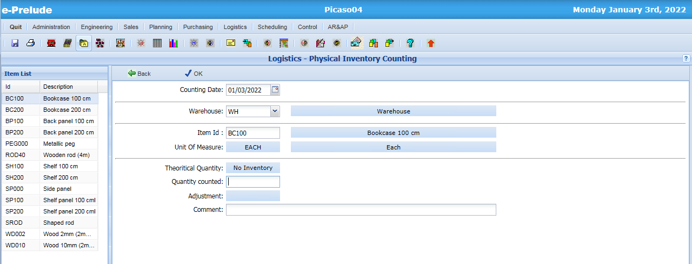
Physical Inventory Counting Entry
Access: Logistics menu, Physical Inventory Counting option
4. Validate
1. Select warehouse WHMAG
3. Enter quantity compted
2. Select each item

Slide 7
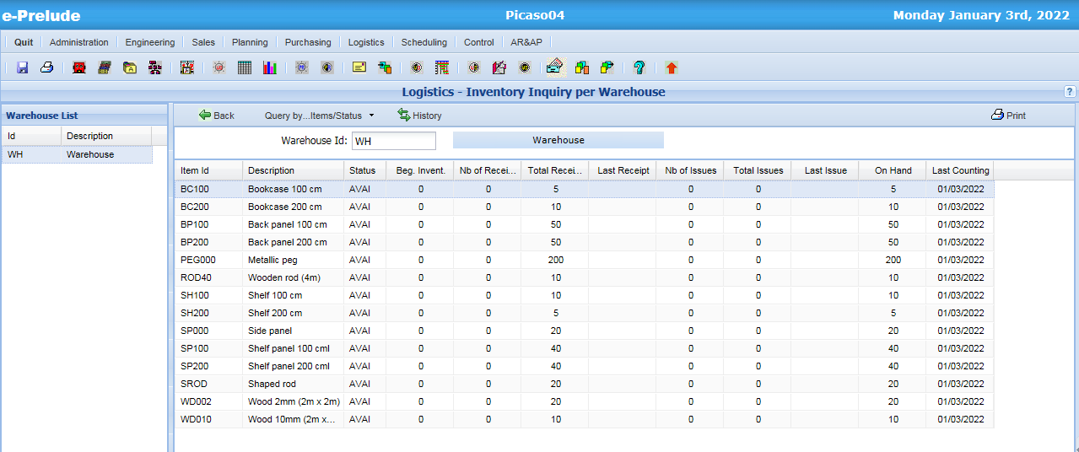
Inventory Inquiry per Warehouse

Slide 8
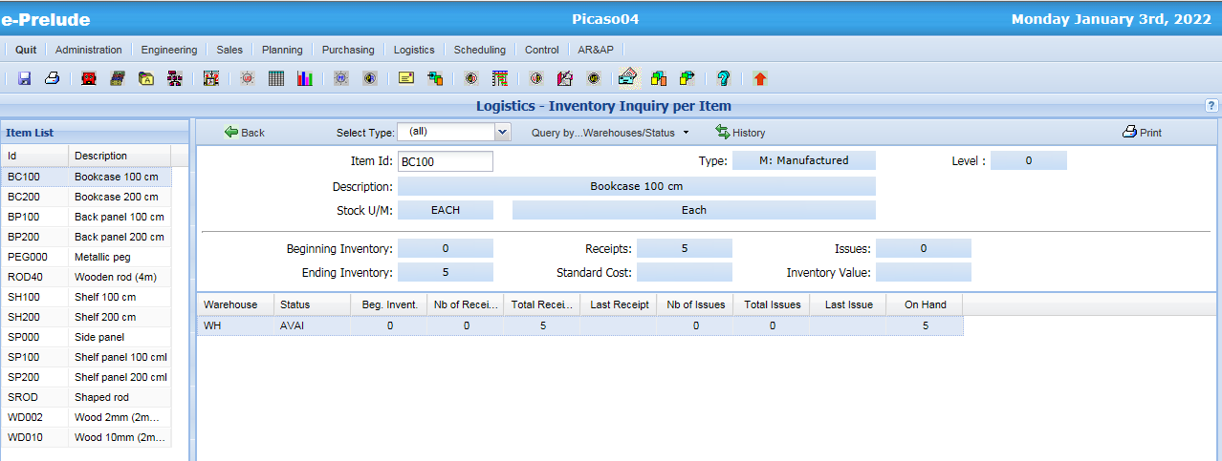
Inventory Inquiry per Item

Slide 9
End of session 4

