Slide 1
e-Prelude.com
Tour - session 6
Production Planning

Slide 2
Production Planning Purpose
Satisfy customer orders
Place purchase orders to vendors
Insure a high capacity utilization
Aim to a minimum inventory level
Provide a work plan to the workshops

Slide 3
Finished good Demand
The planning process starts from
Sales orders
Firm orders
Shipment schedules
Sales forecast
Made by the manufacturer
Inventory look up
For items made to stock if the on-hand quantity is lower than the order point

Slide 4
Calculation of quantities to make and to source
General principle: Materials Requirements Planning (MRP)
Alternate method:
Managing inventories
Notes:
La gestion sur stock de type “mini-maxi” est très peu utilsée sauf pour les articles de faible valeur comme les consommables
ex : film étirables, huile de coupe ...

Slide 5
MRP Principle
It starts with end-items (level 0) to generate quantities of immediate components (level 1) using the BOM. These are called gross requirements
By taking into account the existing inventories, it computes the net requirements at this level = Gross requirements – Inventory on hand + Inventory desired level (safety stock)
Future requirements are eventually regrouped (lot sizing)
Similarly, all other levels are analyzed
To position the requirements in time, it takes into account the production/procurement lead times of the items

Slide 6
Level 0 : Finished goods
Gross Requirements =
Orders/Forecasts
FG Inventory
and assembly WIP
Finished Good Assembly Orders
Finished Good Net Requirements
Level 1 : Sub-assemblies
Finished Good BOM
Sub-assembly Gross Requirements
Sub-assembly inventory
and manufacturing WIP
Sub-assembly Manufacturing Orders
Sub-assembly net requirements
Level 2 : Parts
Sub-assembly BOM
Part Gross Requirements
Part Inventory
and fabrication WIP
Part Fabrication orders
Part Net Requirements
Level 3 : Materials
Part BOM
Material Gross Requirements
Material Inventory
and open purchase orders
Material Net Requirements
Purchase orders
Notes:
La procédure de planification se déroulera en deux phases :
- niveau MPS (produits finis)
- validation manuelle des ordres proposés
- niveau MRP (tous les autres articles)
- validation manuelle des ordres proposés

Slide 7
Taking into account the production lead time
Parent Item Release Date
Parent Item
Requirement Date
Manufacturing Lead Time
Date of component requirements
To determine the release dates (for the parts to be produced) and those of the purchase orders (for the parts to be purchased), one must take into account the lead time required to obtain the parts (expressed in days).
For purchased parts, the lead time is the Delivery Lead Time of the supplier
For the parts produced internally, it is the time required to complete all the production stages of a batch of products. This time is defined in the routings.

Slide 8
Taking into account the procurement lead time (for purchased items)
Date of purchasing order issue
Material requirement date
Procurement lead time
Specifies in days on the item Reorder Policy page

Slide 9
Lot-Sizing Decisions
MRP determines net requirements but tries to optimize orders
Main Techniques:
Lot for lot
Economic Order Quantity (EOQ)
Part Period Balancing
Algorithms or heuristics
Disadvantages : they increase the levels of inventories

Slide 10
Lot sizing decisions
Goal:
Avoid creating too many work or requisition orders in a short period of time
Thus reduce the number of production orders releases or purchase orders
which generate fixes costs (clerical work, changeover time, transportation, …)
but...
creation of inventory
(because a requirement is anticipated)

Slide 11
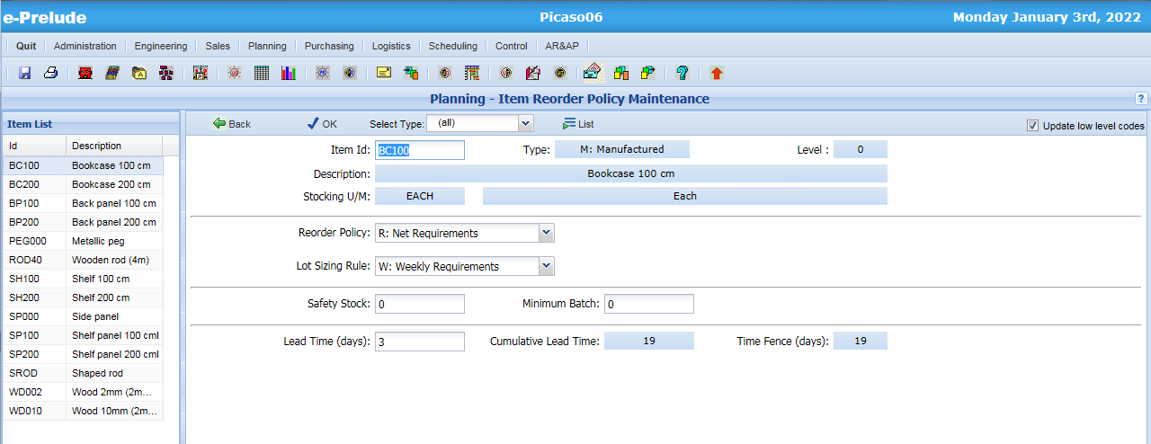
Item Management Parameters
Access: Planning menu, Item Reorder Policy option
4- Validate
1 - Select the Reorder policy
2 - Select the lot sizing rule
3- Specify the production lead time

Slide 12
A production process
Material
X
Sub-assembly
SA 1
Part
A
Sub-assembly
SA 2
Finished good
Material
Y
Part
B
Sub-assembly
SA 3
Routing
Routing
Routing
Notes:
La gamme décrit le processus pour passer d’un niveau de la nomenclature au niveau supérieur

Slide 13
Production planning steps
Requirements
Manufactured items
Purchased items
MRP calculation
Planned Work Orders
Planned requisition orders
Conversion
Conversion
Firm Work Orders
Firm requisition orders
Order release
Purchase order entry
Open Work Orders
Purchase Orders
Execution
Receipt
Closed Work Orders
Closed Purchase Orders

Slide 14
Successive Work Order status
Planned WO
Firm WO
Open WO
Closed WO

Slide 15
Work order status depending on the time horizon
Current date
Closed WO
Open WO
Firm WO
Planned WO
time
WO Release end date
WO Conversion end date
MRP Calculation end date

Slide 16
A calendar
The plant calendar defines working days
Requirements offsets are calculated on working days
Example:
There is a requirement for item A with a lead time of 6 days for Wednesday of week 3
The release date is calculated by moving backward on the calendar of the number of days of the lead time
Release
Requirement
6 days
Mo
Tu
We
Th
Fr
Sa
Su
Mo
Tu
We
Th
Fr
Sa
Su
Mo
Tu
We
Th
Fr
Sa
Su
Week 1
Week 2
Week 3

Slide 17
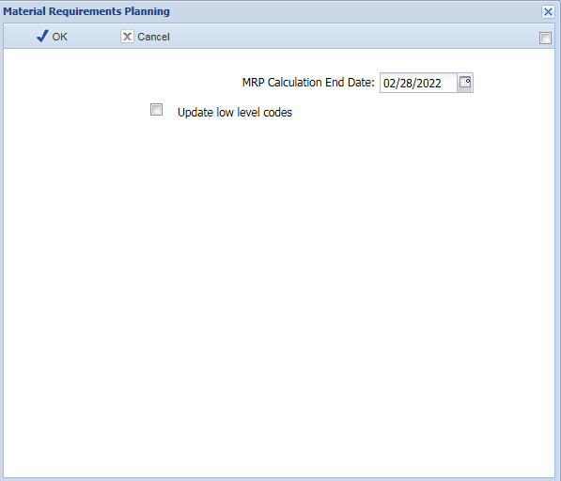
Materials Requirements Planning
Access: Planning menu, Material Requirements Planning option
Specify a calculation end date to avoid generating orders for far demands
Items are processed by increasing level order

Slide 18
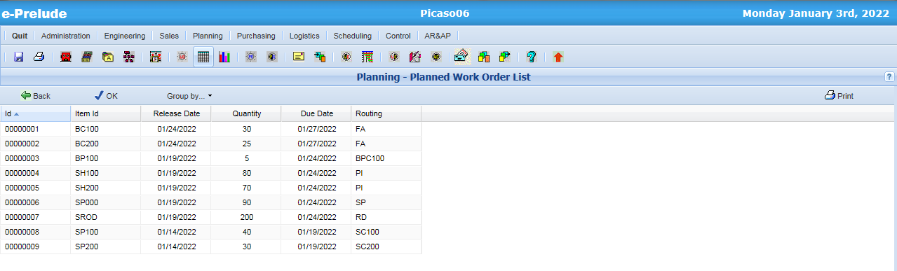
Planned Work Order List
Access: Planning menu, Planned Work Order List option

Slide 19
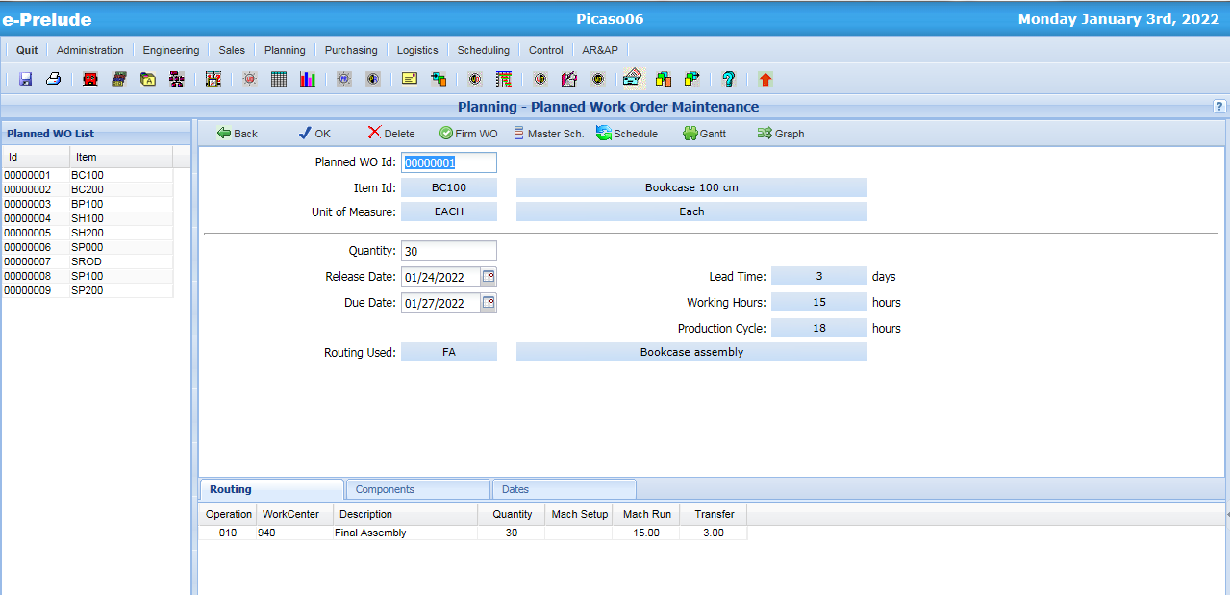
The Planned Work Order window
Access: Planning menu, Planned Work Order Maintenance option

Slide 20
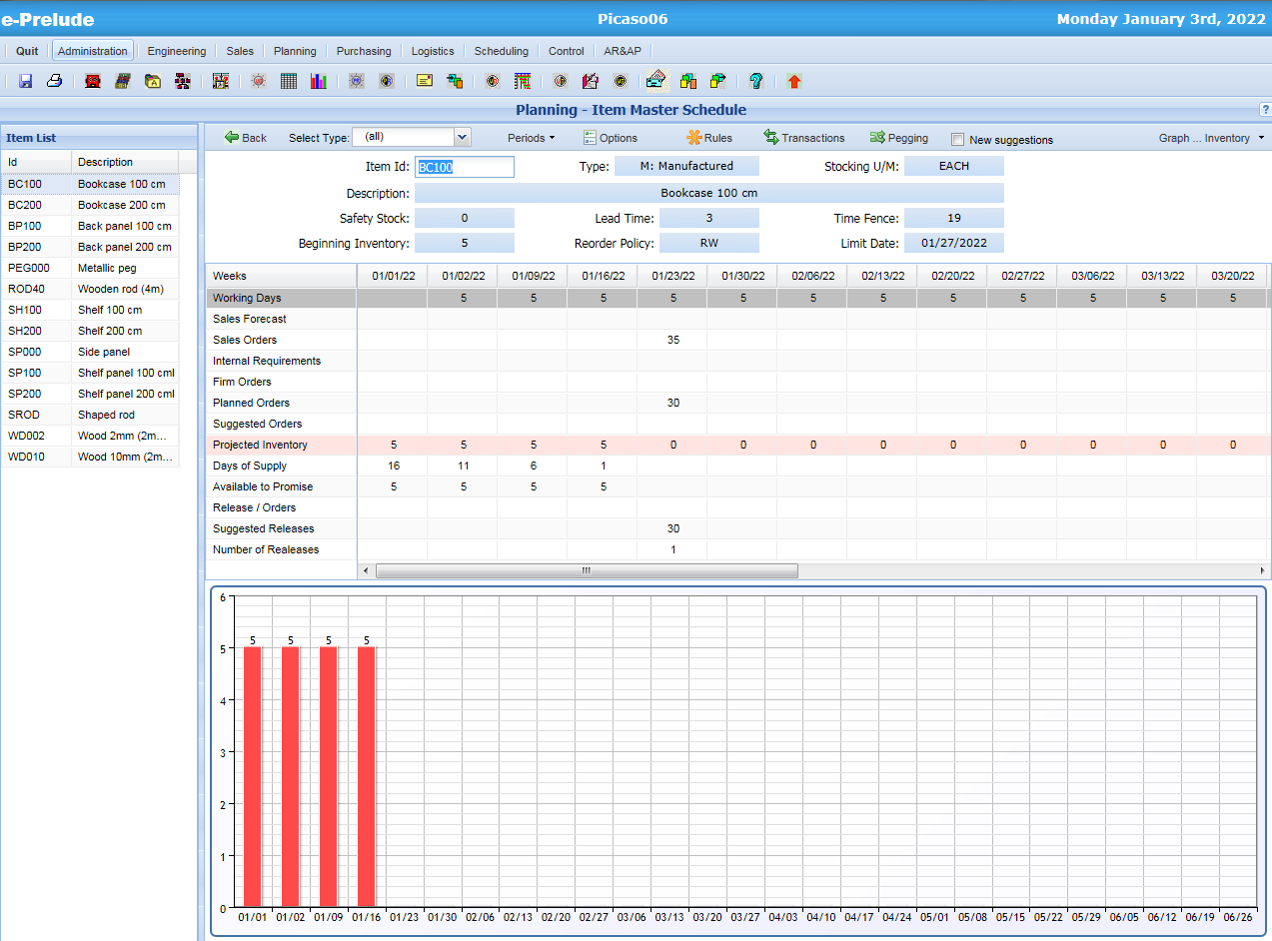
Item Master Schedule
Access: Planning menu, Master Schedules option
Planned orders appear in the Master Schedule
Inventory Profile is updated

Slide 21
Scheduling and capacity utilization
WO are scheduled using infinite capacity loading
One after the previous without taking into account the number of available machines on the work center
Operations are placed with times calculated from the routings on work center time slots (calendar)
forward (starting from the release date)
backward (starting from the due date)
Work loads are cumulated on each time slot

Slide 22
Work center schedules
Using the calendar, determination of working time slots for each work center
WC 1
8h
8h
8h
8h
8h
Mo 8:00
Tu 8:00
We 8:00
Th 8:00
Fr 8:00
WC 2
8h
8h
8h
8h
8h

Slide 23
Scheduling of a Work Order Example
Release date: Monday
Due date: Friday (must be finished on Thursday night)
Operation 010 on WC 1, duration 10 hours (setup time + run time) + 3 hours for transfer
Operation 020 on WC 2, duration 12 hours (setup time + run time) + 3 hours for transfer

Slide 24
Forward scheduling
Release date
Due date
WC 1
8h
8h
8h
8h
8h
Mo 8:00
Tu 8:00
We 8:00
Th 8:00
Fr 8:00
WC 2
8h
8h
8h
8h
8h
Op. 010
10h
3h
Op. 020
12h
3h
Slack: 4h
Earliest end date

Slide 25
Backward scheduling
Release date
Due date
WC 1
8h
8h
8h
8h
8h
Mo 8:00
Tu 8:00
We 8:00
Th 8:00
Fr 8:00
WC 2
8h
8h
8h
8h
8h
Op. 010
10h
3h
Op. 020
Latest start date
12h
3h
Slack: 4h

Slide 26
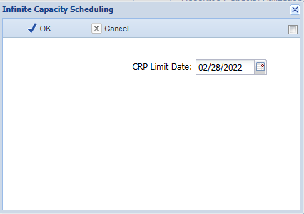
Infinite Capacity Scheduling
Access: Planning menu, Infinite Capacity Scheduling option
Specify a calculation end date to avoid useless calculations

Slide 27
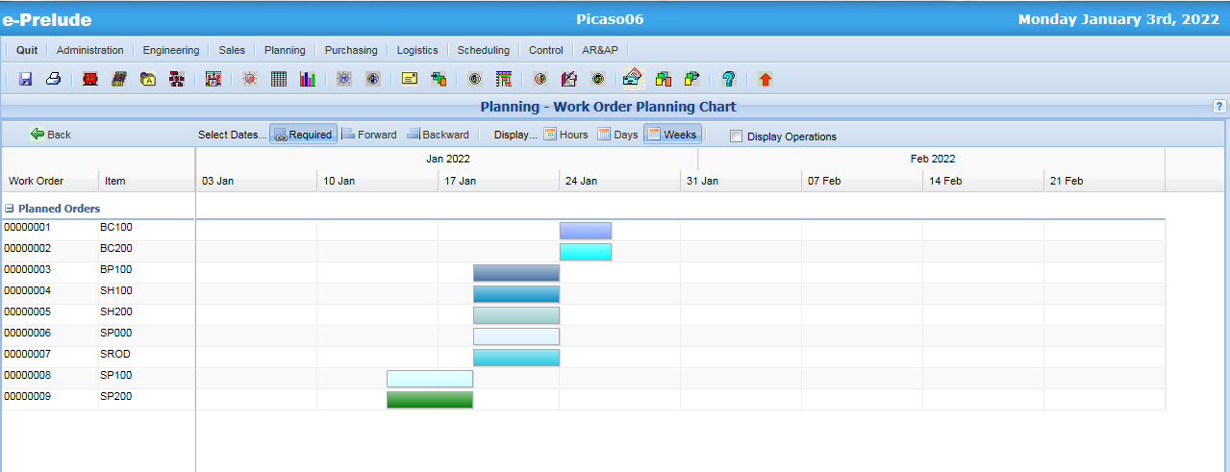
Infinite Capacity Scheduling Chart
Access: Planning menu, Scheduling Chart option

Slide 28
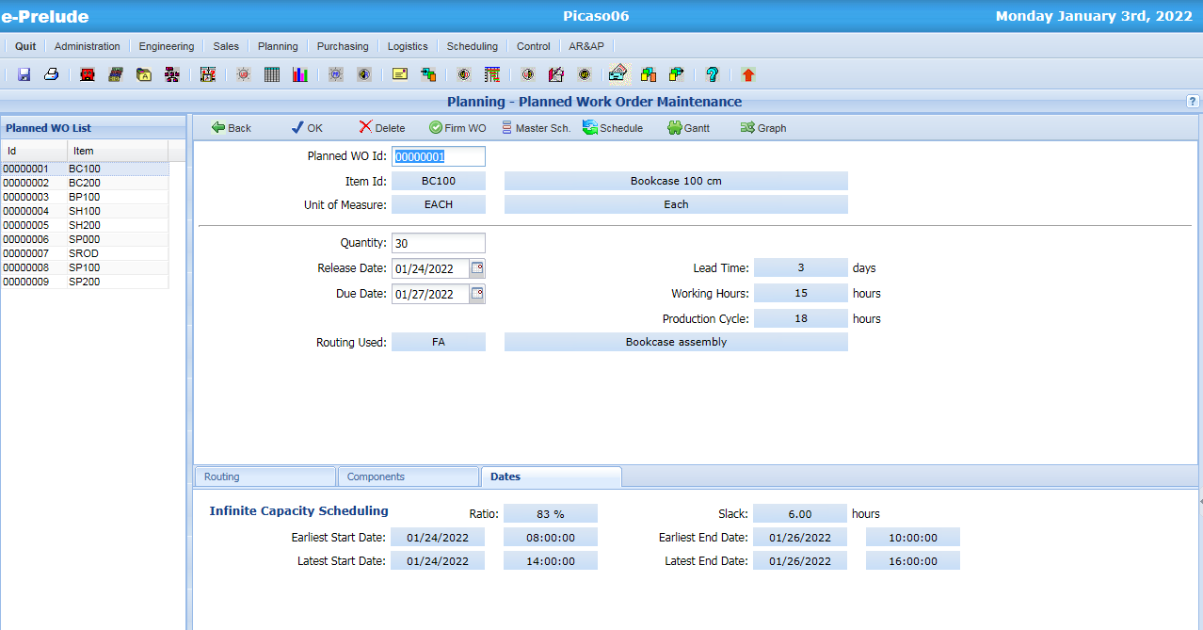
Infinite Capacity Schedule Dates
Access: Planning menu, Planned Work Order Maintenance option
Scheduling dates are calculated

Slide 29
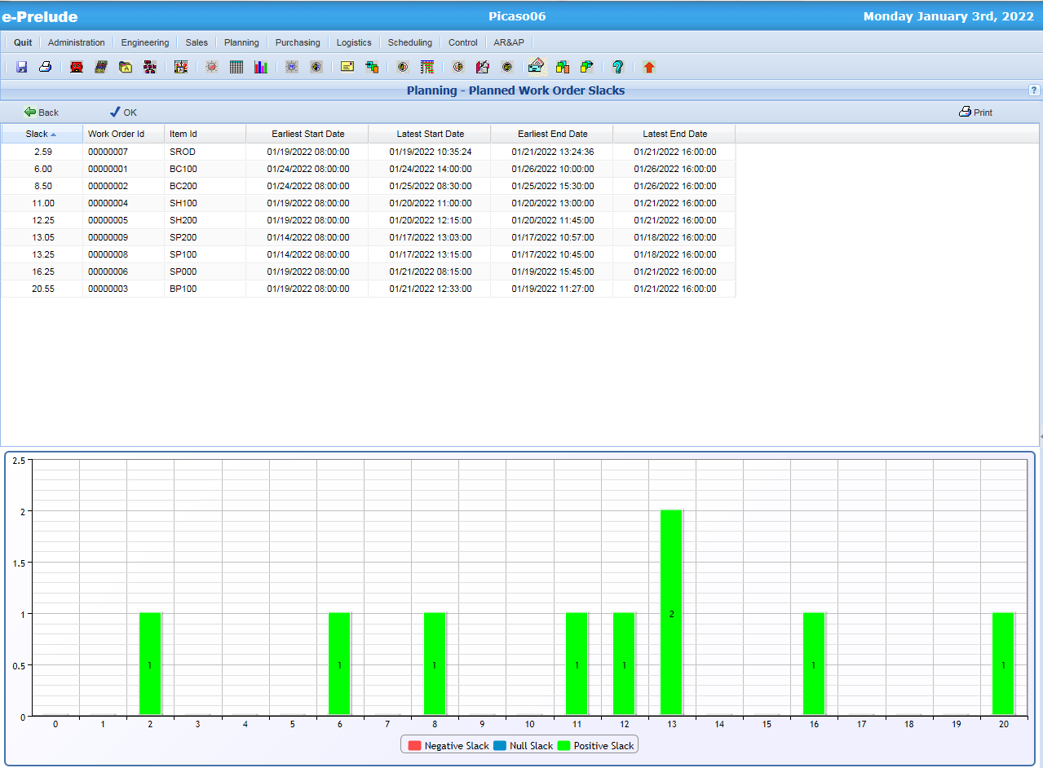
Work Order Slack Analysis
Access: Planning menu, Planned Work Order Slacks option

Slide 30
Capacity Utilization
On each time slot, work loads originating from WO are cumulated
For Forward and Backward schedules
WC 1
8h
8h
8h
8h
8h
Mo 8:00
Tu 8:00
We 8:00
Th 8:00
Fr 8:00
WO 1
4h
6h
WO 2
4h
8h
2h
WO 3
2h
8h
5h
Work Load
4h
12h
16h
7h

Slide 31
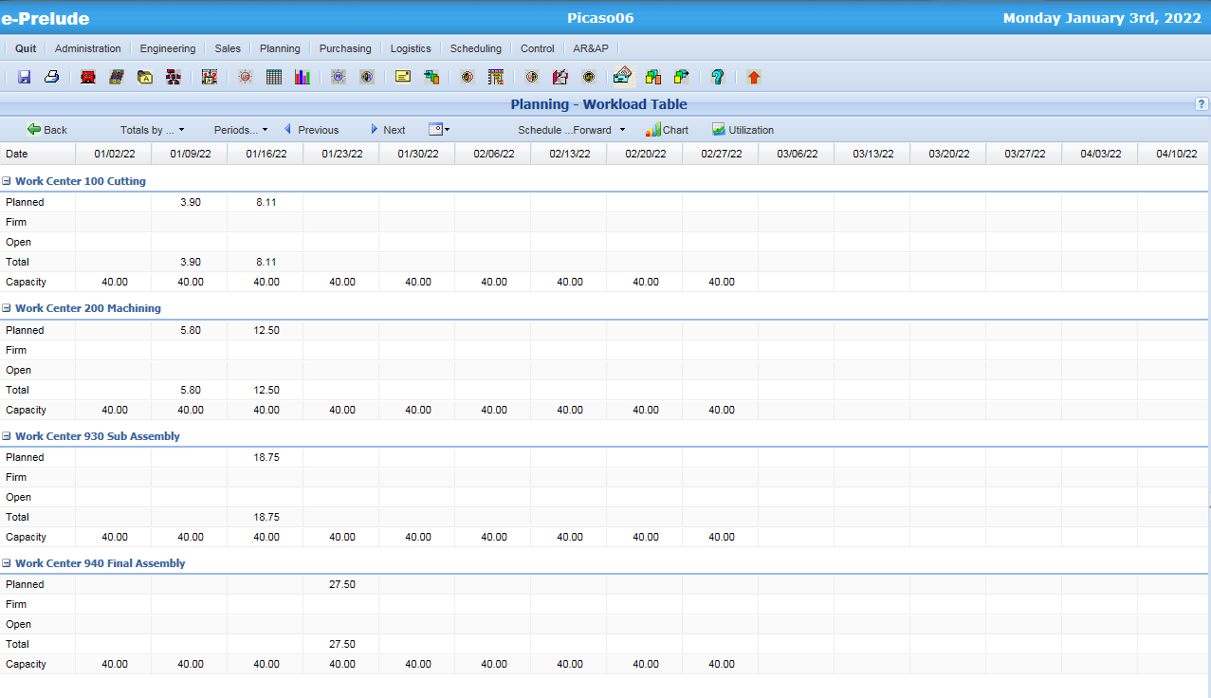
Work Load Table
Access: Planning menu, Scheduling Chart option

Slide 32
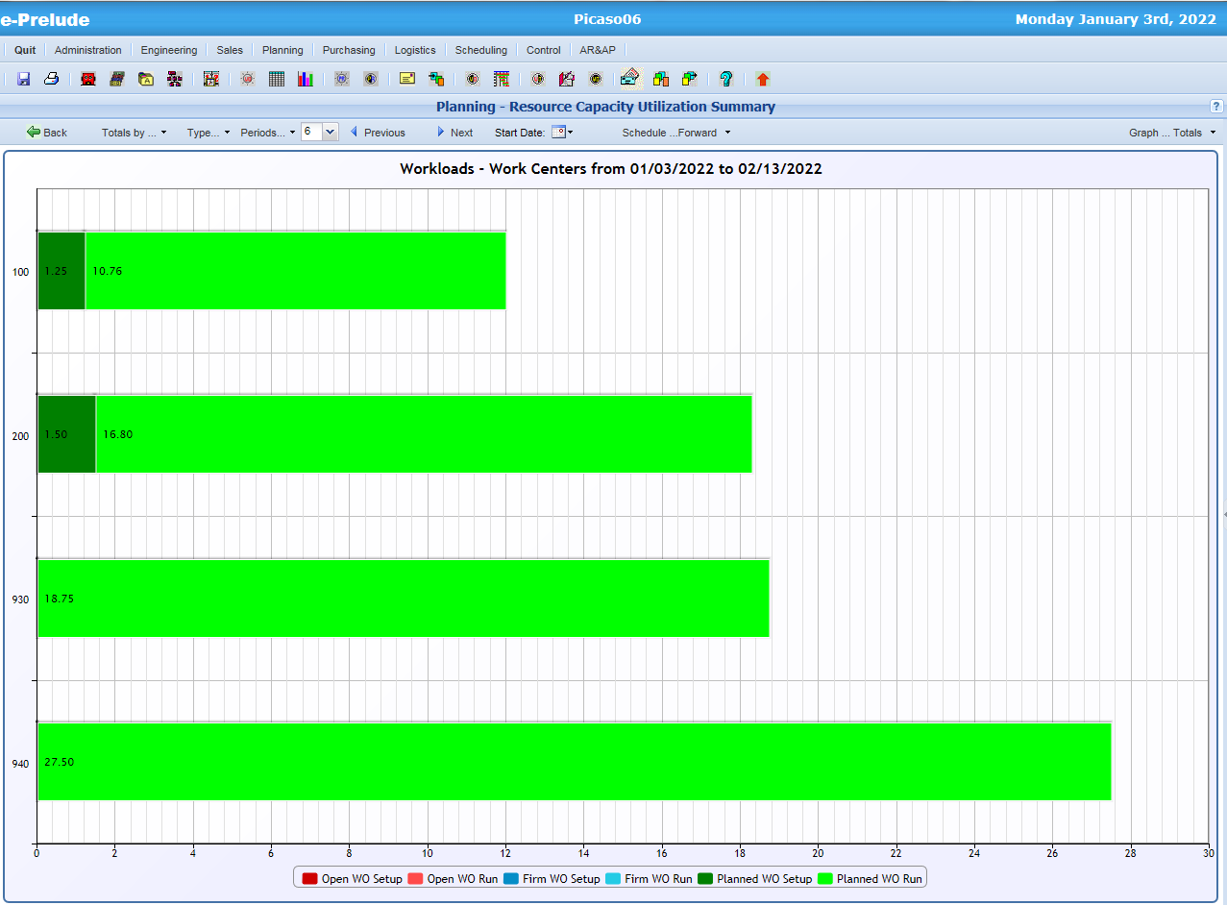
Work Capacity Utilization Summary
Access: Planning menu, Resource Capacity Utilization Summary option

Slide 33
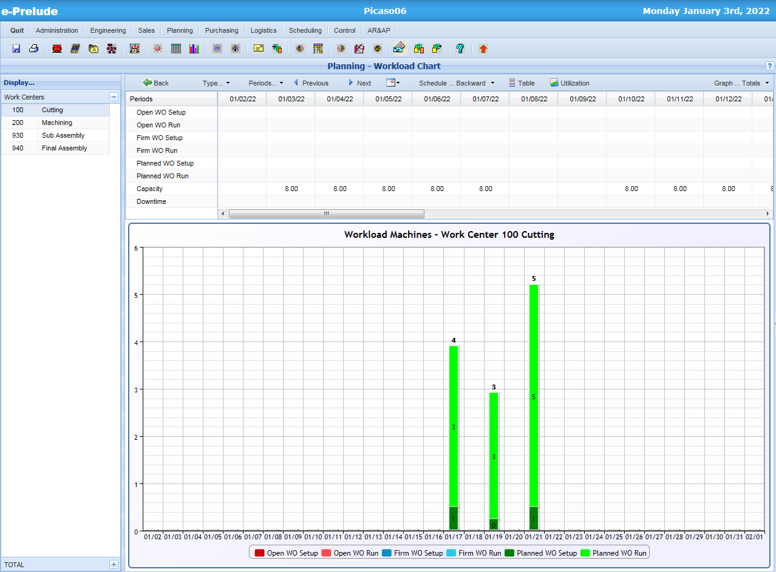
Workload Chart
Access: Planning menu, Workload Chart option

Slide 34
End of session 6

