Slide 1
e-Prelude.com
Tour - session 7
Purchasing Process

Slide 2
The purchasing process
PR : Purchase Requisition
MRP
Planned PR
Conversion to Firm
Firm PR
Purchase Order entry
Purchase Orders
Receipt
Closed Purchase Orders

Slide 3
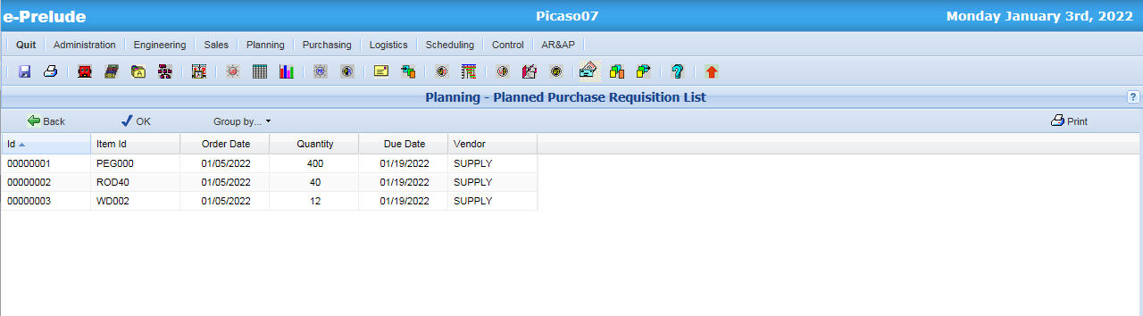
Planned Purchase Requisitions
Access: Planning menu, Planned Purchase Requisition List option
Planned Purchase Requisitions generated by MRP

Slide 4
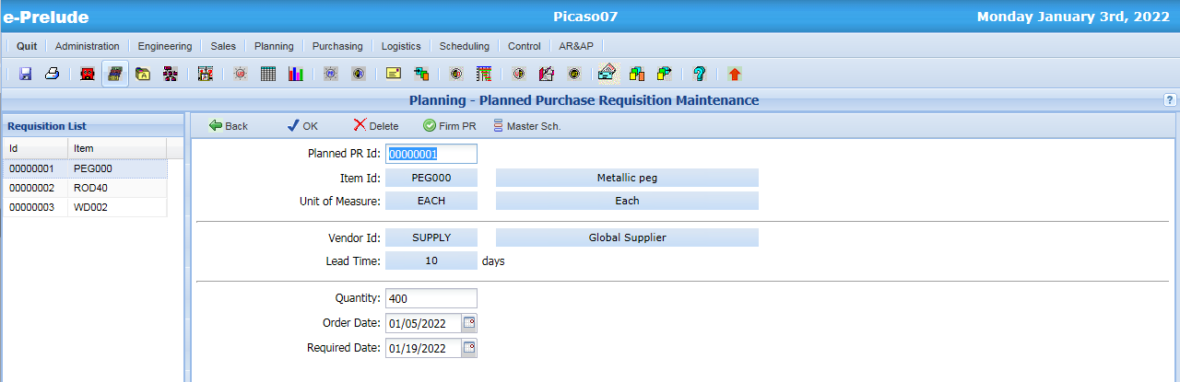
Planned Purchase Requisitions
Access: Planning menu, Planned Purchase Requisition Maintenance option
A Planned Purchase Requisition can be converted to a Firm Purchase Requisition

Slide 5
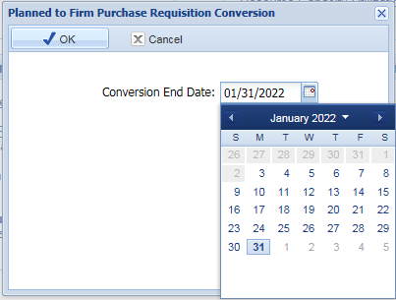
Purchase Requisition Conversion
Access: Planning menu, Planned Purchase Requisition Conversion option
Automatic conversion of all Planned Purchase Requisitions (with an order date earlier or equal to the specified date)
into Firm Purchase Requisitions

Slide 6
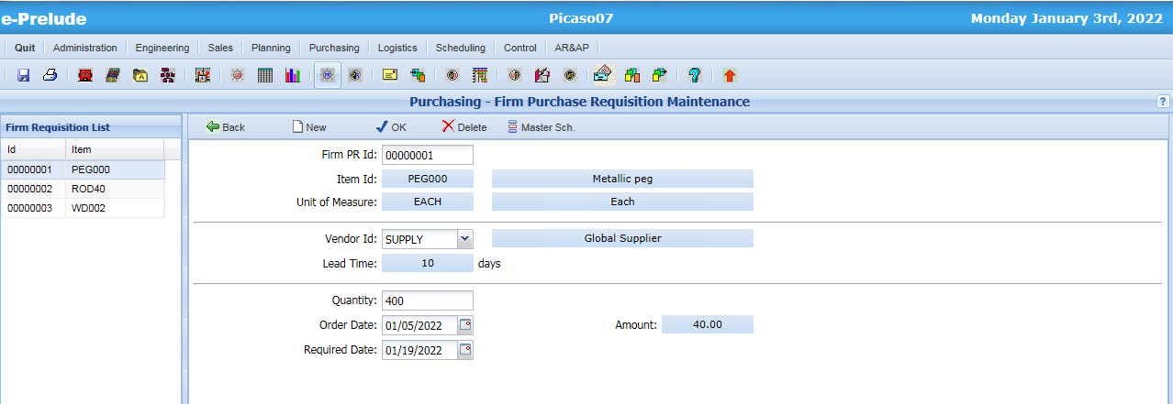
Firm Purchase Requisitions
Access: Purchasing menu, Firm Purchase Requisition Maintenance option
Can be created manually

Slide 7
The Purchasing Process
Logistics
Purchasing Department
Vendor
Purchase order entry and approval
Purchase Order
Purchase Order Receipt
Materials
Receiving Note
Vendor Invoice verification and recording
Invoice
Payment
Payment

Slide 8
Purchase Order Entry
Purchase Orders can be created
By conversion of Firm Purchase Requisitions into Purchase Orders
By manual entry (independently from the planning process)
Purchase Order Creation
Enter the Order Header
Enter the Order Lines or integrate Firm Purchase Requisitions
Purchase Order Approval

Slide 9
Purchase Order Structure
Vendor A
Order 1
Line 1
Item X, qty 10
Line 2
Item Y, qty 5
Order 2
Line 1
Item X, qty 20
Vendor B
Order 3
Line 1
Item Z, qty 3
Line 2
Item Y, qty 8
Order 4
Line 1
Item X, qty 10
Line 2
Item T, qty 100
Line 3
Item U, qty 200

Slide 10
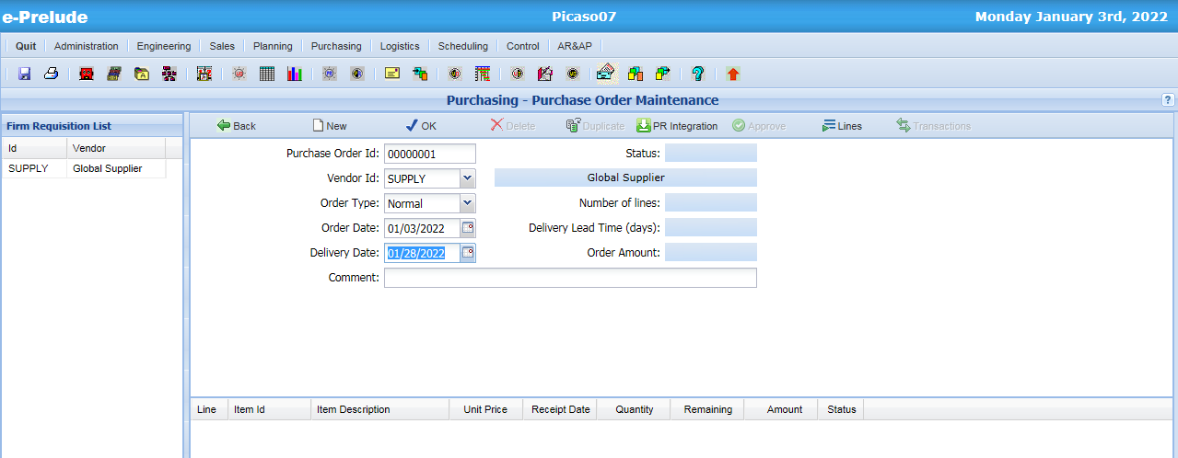
Purchase Order Header
Access: Purchasing menu, Purchase Order Maintenance option
4- Enter Order lines
or integrate Purchase Requisitions
1- Click on ‘ New ’ The first available order number is posted
2- Enter the vendor code
3- Enter Delivery Date

Slide 11
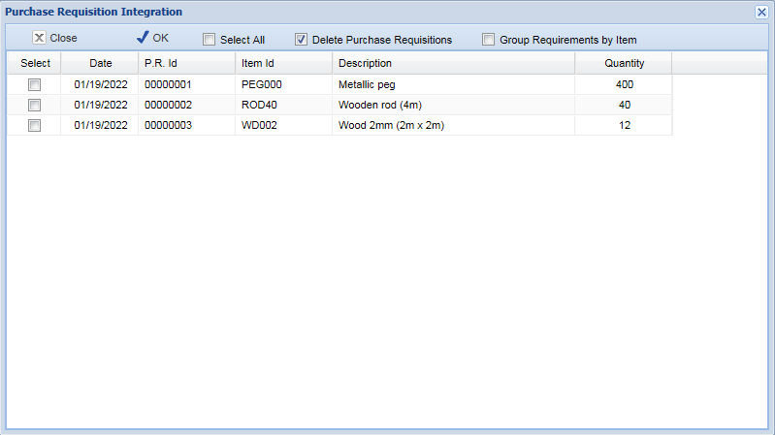
Purchase Requisition Integration
2 - Click on OK to create the Purchase Order Lines
1 - Select all the Purchase Requisitions

Slide 12
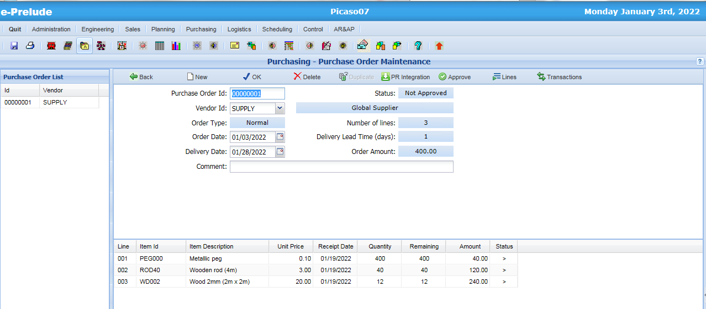
The Purchase Order

Slide 13
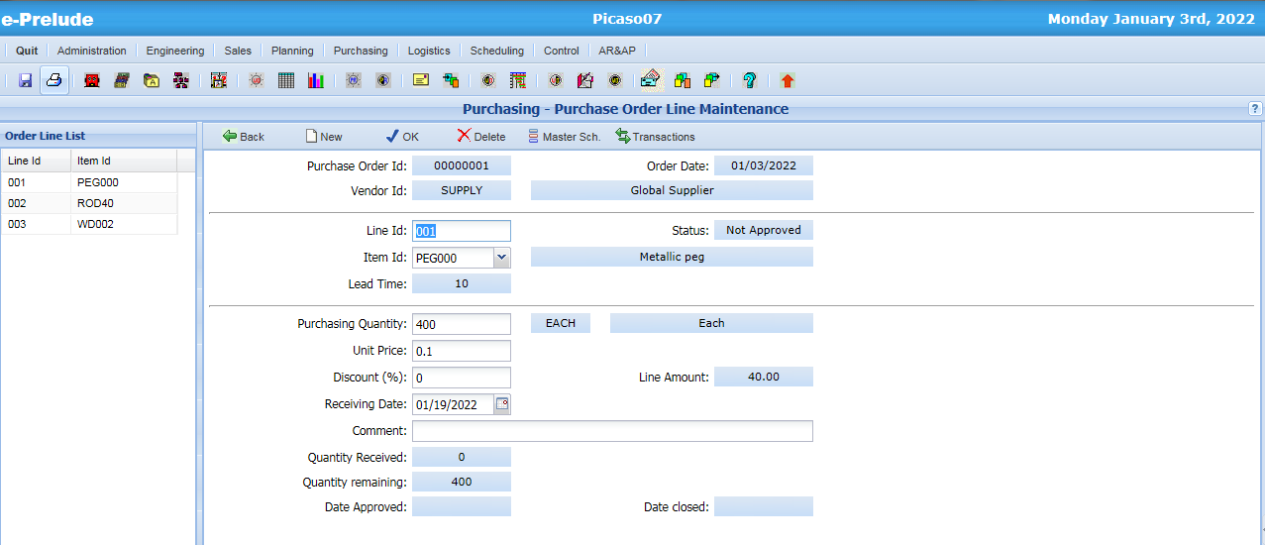
The Purchase Order Line

Slide 14
Purchase Order Approval
As long as a Purchase Order is not approved, it can be modified or deleted
Approval prevents from any later modification ; the purchase order is sent to the vendor ; it is a commitment toward the vendor

Slide 15
Purchase Order Approval
Approve the order

Slide 16
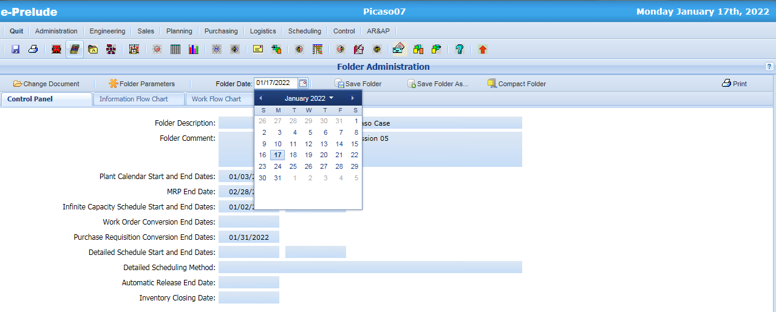
Purchase Order Receipt
Changing Folder Date
Click here to change the date
Select the date

Slide 17
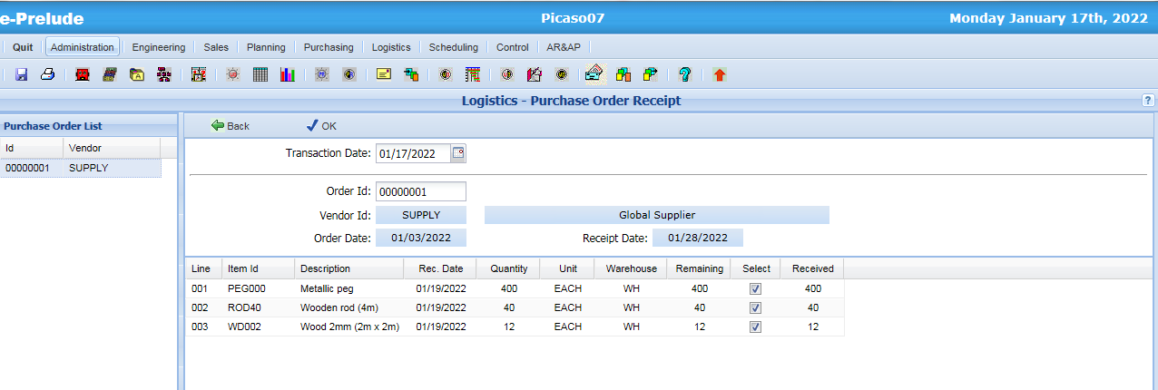
Purchase Order Receipt
Access: Logistics menu, Purchase Order Receipt option
Click on ‘ OK ’
to record the receipt of all checked lines
Click in the ‘Sel’ column to check / un-check a line

Slide 18
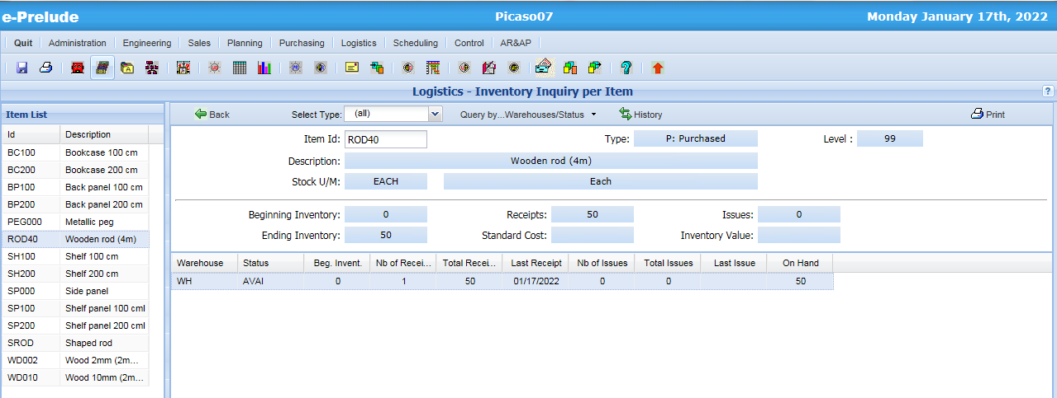
Inventory Transaction
Access: Logistics menu, Inventory Inquiry by Item option
Click on ‘History’

Slide 19
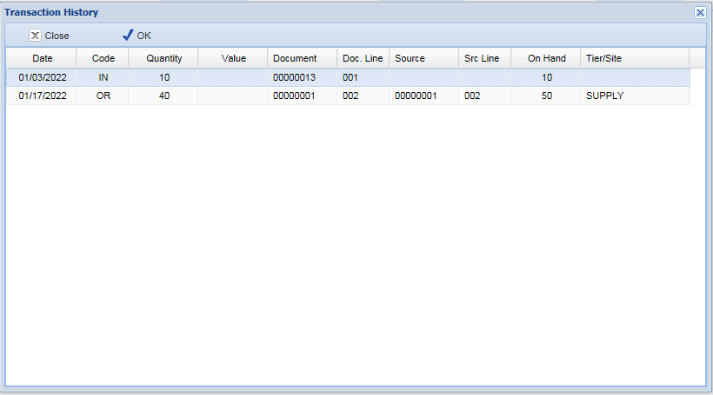
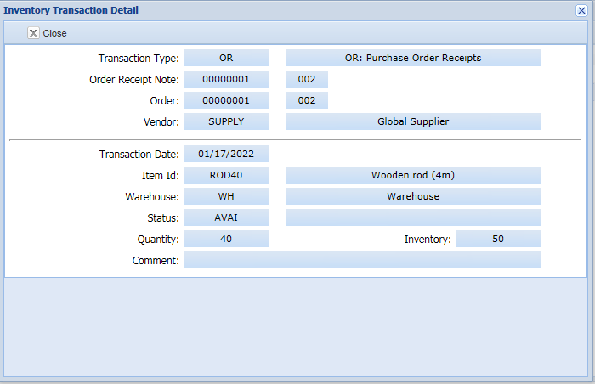
Inventory Transaction
Click on ‘ OK ’
Transaction Code OR:
Order Receipt

Slide 20
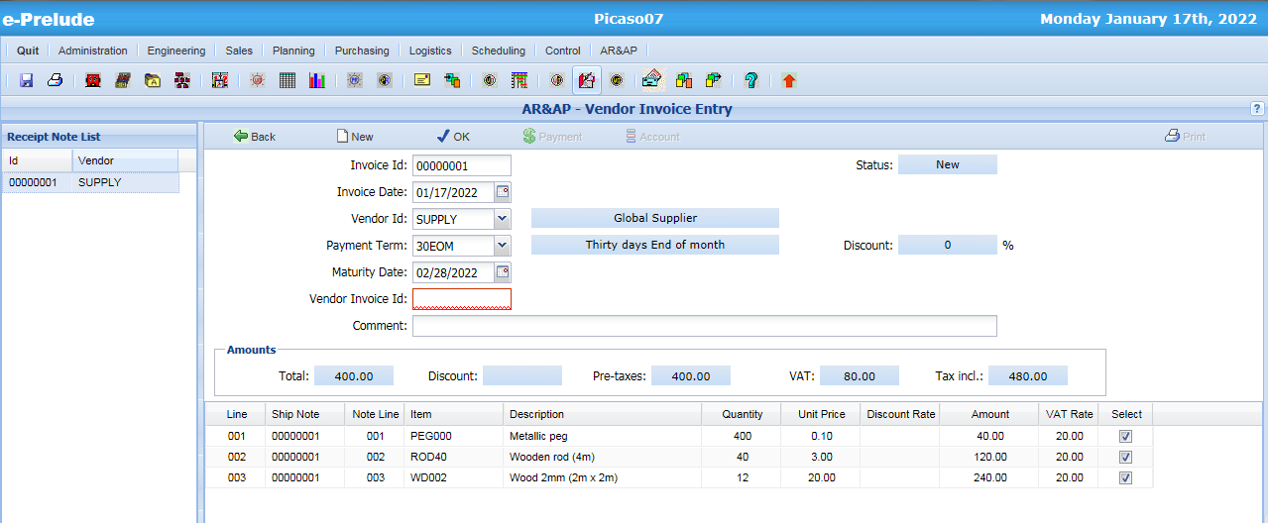
Recording Vendor Invoice
Access: AR&AP menu, Vendor Invoice Entry option
1 - Click on ‘New’
2 – Recall vendor code
4. Validate
3 - Enter (any) vendor invoice number
Receipts not yet invoiced are posted

Slide 21
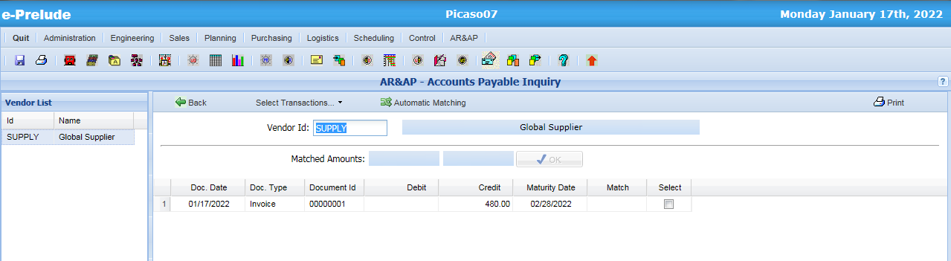
Account Payable Inquiry
Access: AR&AP menu, Accounts Payable Inquiry option

Slide 22
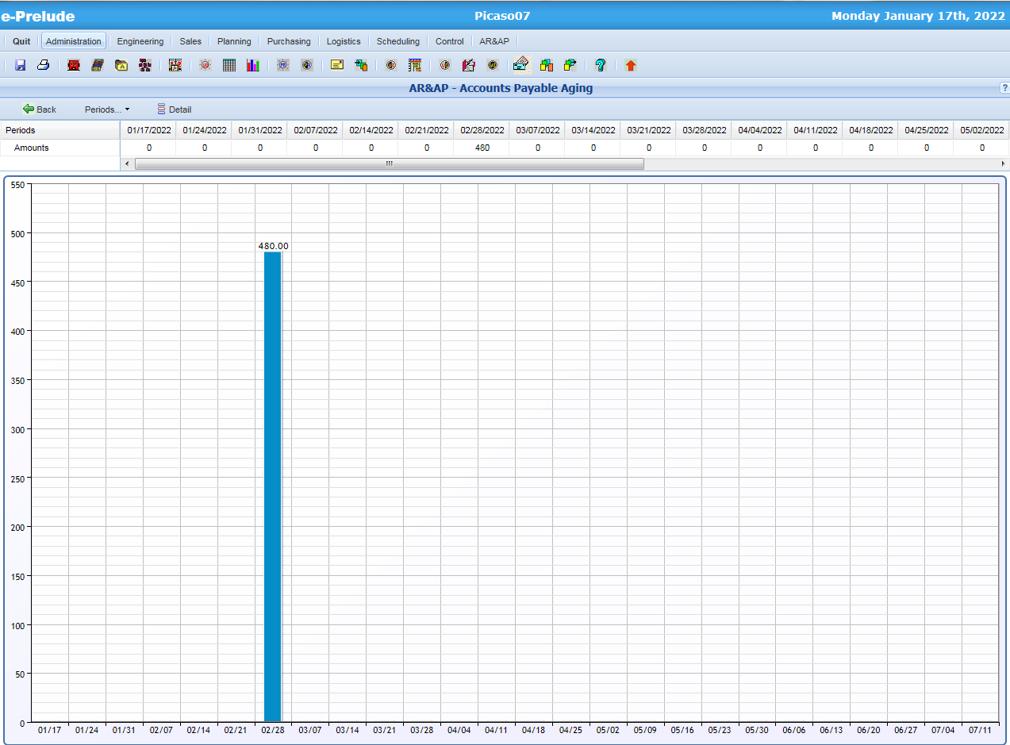
Account Payable Aging
Access: AR&AP menu, Accounts Payable Aging option

Slide 23
End of session 7

