Slide 1
e-Prelude.com
Tour - session 9
Work Order Release and Production Activity Control

Slide 2
Work Order Release
Check availability of components
Convert a Firm Order into an Open Order
Prepare all documents required for Production Activity Control
Shop Traveler
Job Tickets

Slide 3
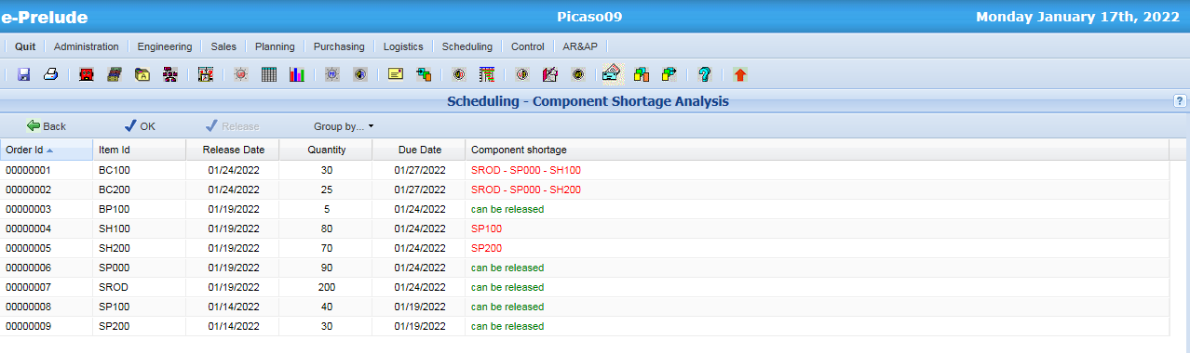
Checking availability of components
Access: Scheduling menu, Shortage Analysis option

Slide 4
Order Release
Firm WO
Open WO
The Firm Work Orders become Open Work Orders (O)
Creation of In-process Operations
Shop Traveler
Components are reserved in the inventory:
They change from status AVAIL (Available) to status RESV (Reserved for fabrication)
The quantity to process is set for the first operation

Slide 5
Work Order Dependency
Level 2
Level 1
Level 0
Sub-assembly 1 WO
Finished good WO
Component 1 WO
This WO can be released only when the sub-assembly WO have been receipted into inventory
Sub-assembly 2 WO
Component 2 WO
These WO can be released only when the component WO have been receipted into inventory

Slide 6
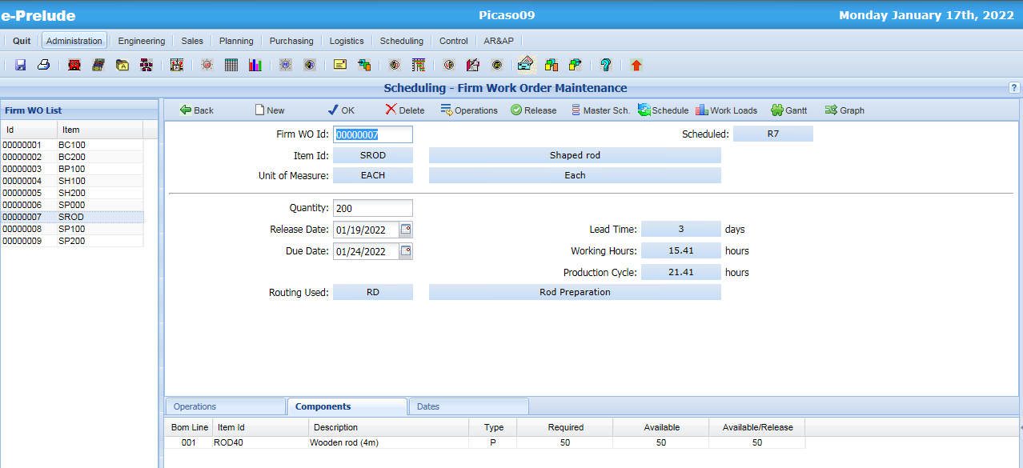
Firm Work Order Release
Access: Scheduling menu, Firm Work Order Maintenance option
Release the order
Availability of components

Slide 7
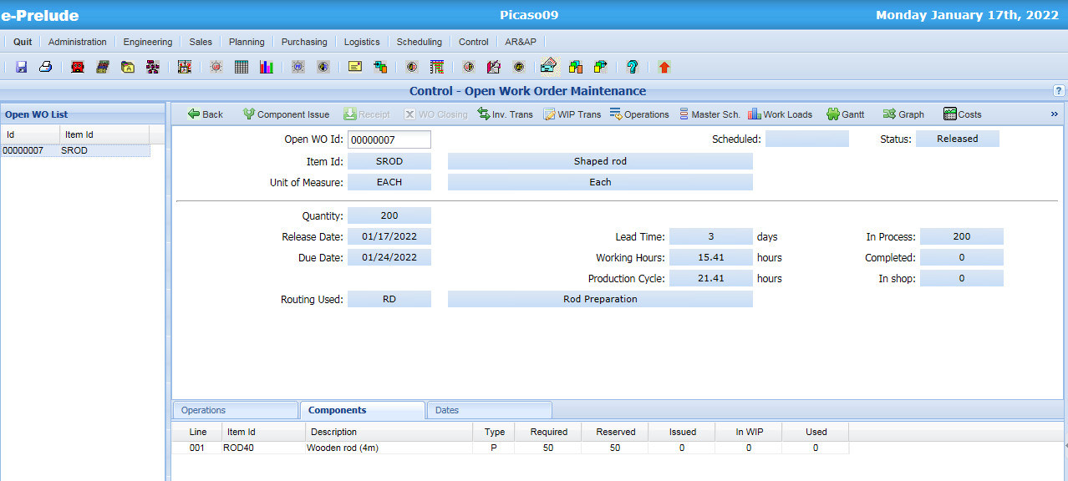
An Open Work Order
Access: Control menu, Open Work Order Maintenance option
Components are reserved

Slide 8
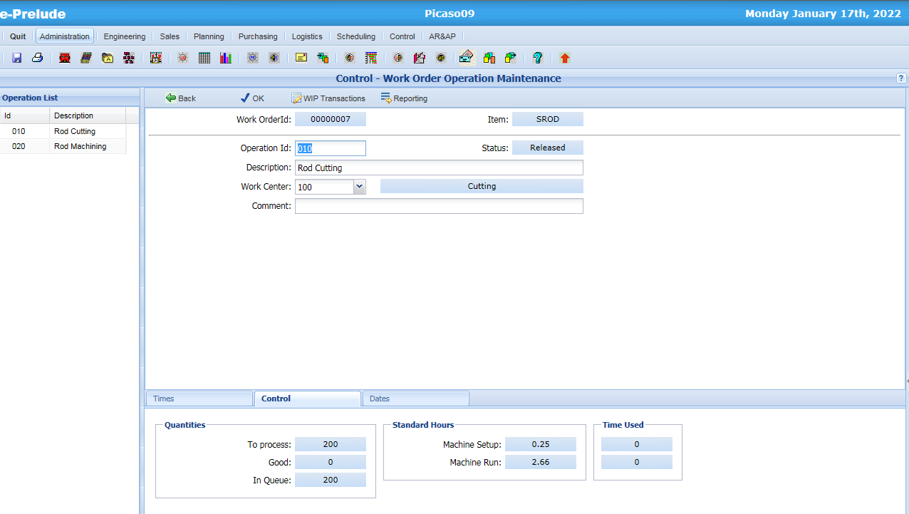
Operations in WIP
Access: Control menu, Open Work Order Maintenance option, Operations button

Slide 9
Components Reservation
WO x
item A
Quantity 100
Component Warehouse
Status
Available (AVAIL)
Reserved for fabrication (RESV)
Component C1
Quantity 100
C1
- 100
+ 100
C2
- 200
+ 200
Component C2
Quantity 200
The transfer between status is done in the warehouse
specified on the item form of each component
The type of transactions on components change: from type FR (Firm Requirement) to type RR (Released Requirement)

Slide 10
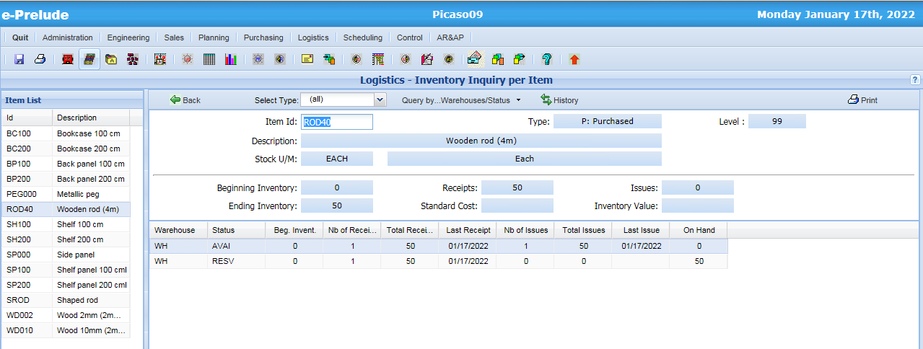
Component Inventory reserved for Open Work orders
Access: Logistics menu, Inventory by Item option

Slide 11
Automatic Work Order Release
Releases all the Firm Work Orders
if all their components are available
sorted by increasing release date
with a release date earlier than or equal to the date specified

Slide 12
Production Activity Control
Consists in recording
The progress of manufacturing operations
Number of parts processed
Parts good, scraps
Resource consumption
Machine hours
Labor hours
Material and components used
Incidents
Machine or tool breakdown
Waiting for parts handling, for personnel, …

Slide 13
Management of an Open Order
Open WO
Closed WO
Main steps:
Work Order component issue
Report of quantities processed
Report of time used
Work Order Receipt into warehouse
Work Order Closing

Slide 14
Management of an Open Order
Components Warehouse
Workshop
Finished Goods
Warehouse
Component Issue
Op. 010
Op. 020
FG receipt
Waiting
Qty good
Waiting
Qty good
Qty completed
Reporting Op. 010
Reporting Op. 020

Slide 15
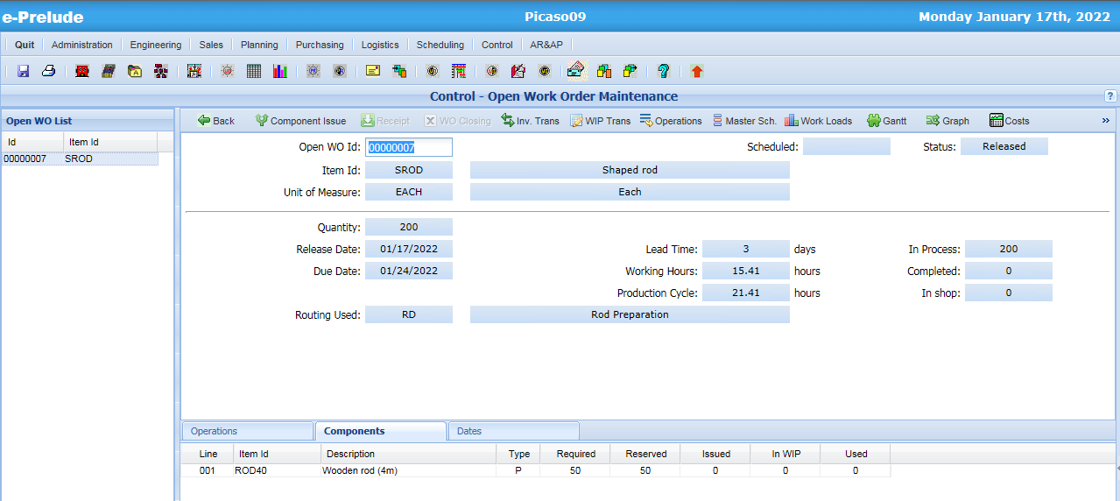
Work Order Component Issue
Access: Control menu, Open Work Order Maintenance option
Click on ‘Component Issue’
Components are reserved

Slide 16
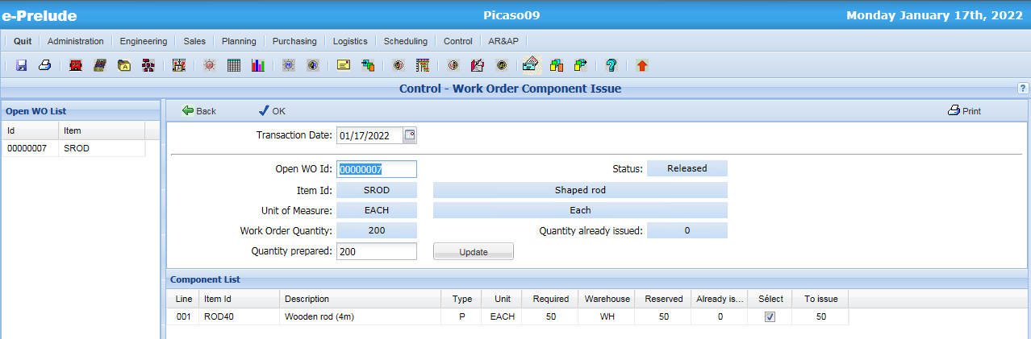
Work Order Component Issue
1- Click on ‘OK’ to proceed to Component Issue
2- Click on ‘Back’
Components are reserved

Slide 17
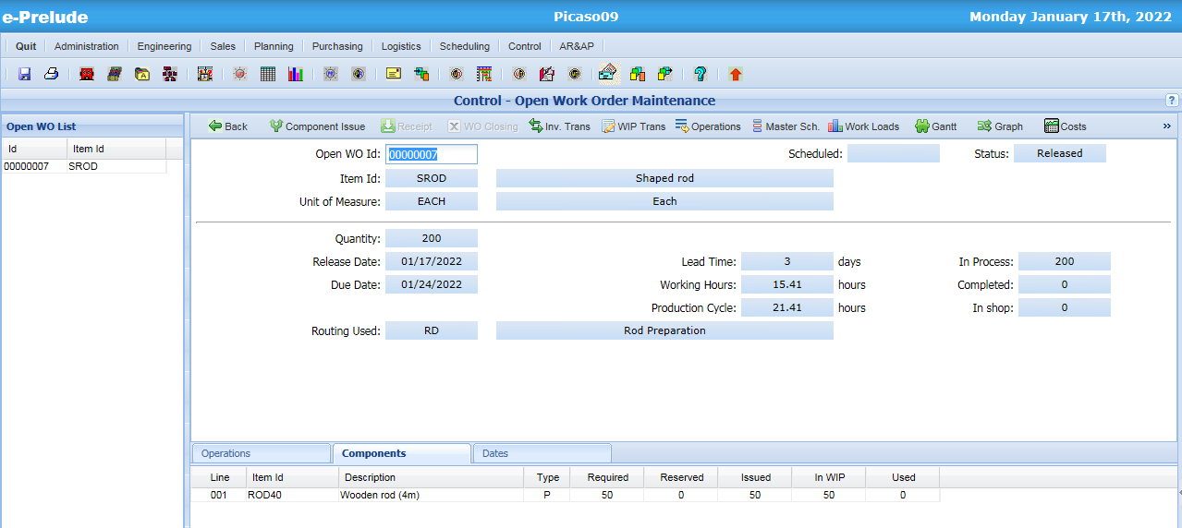
Work Order Component Issue
Access: Control menu, Open Work Order Maintenance option
Components are issued and are in the WIP (Work In Process)

Slide 18
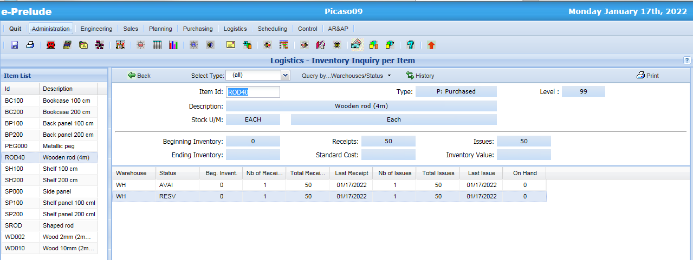
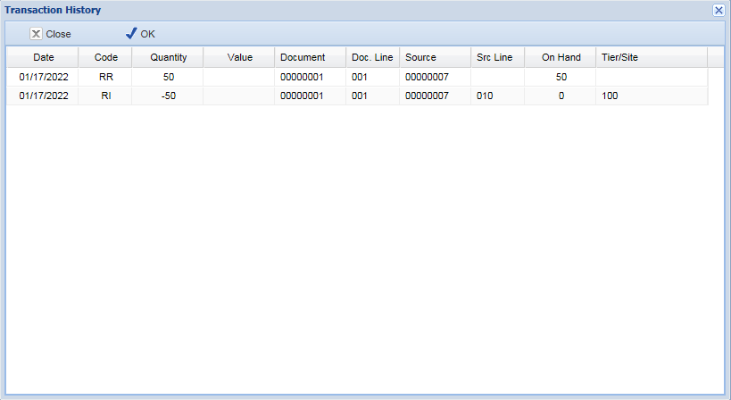
Components are issued from reserved inventory

Slide 19
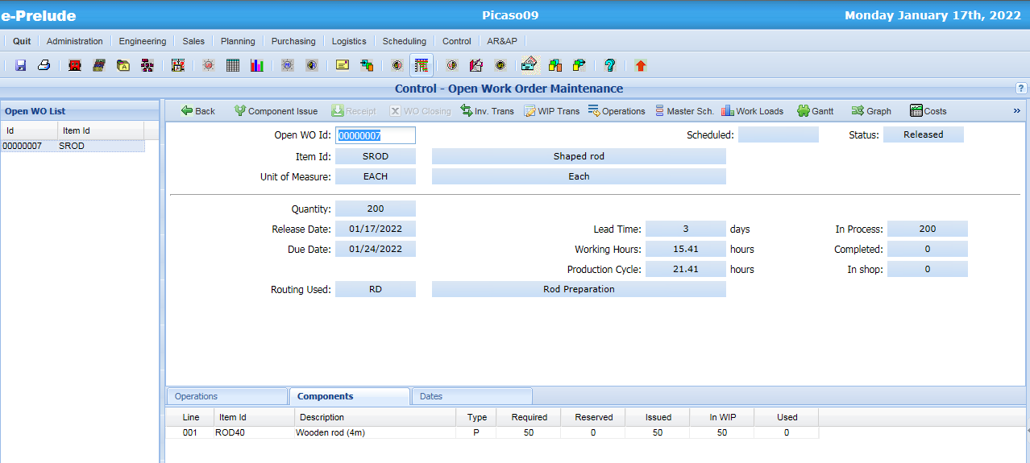
Components in-process
Access: Control menu, Open Work Order Maintenance option
Components are issued from
Reserved inventory
and are located in WIP

Slide 20
Open Work Order Intermediate Status
Release: status O (Open)
After the first production report: status I (in-process)
When all the quantities have been reported at the last operation: status T (completed)
Closing: status C (Closed)
The operations have the same status

Slide 21
Work order material tracking
Operation 010
Operation 020
Qty
waiting
Qty
good
Qty
waiting
Qty
good
Becomes quantity waiting for the next operation
Reporting of quantity processed, parts good, scrap
Reporting of quantity processed, parts good, scrap

Slide 22
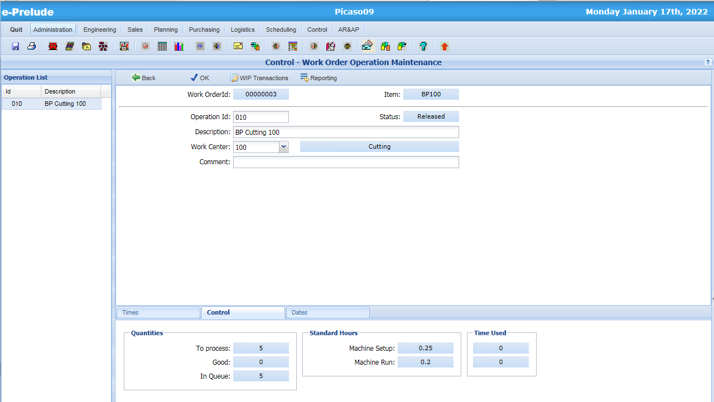
Work Order Operation
Access: Control menu, Open Work Order Maintenance option, Operations button
Click on ‘Reporting’

Slide 23
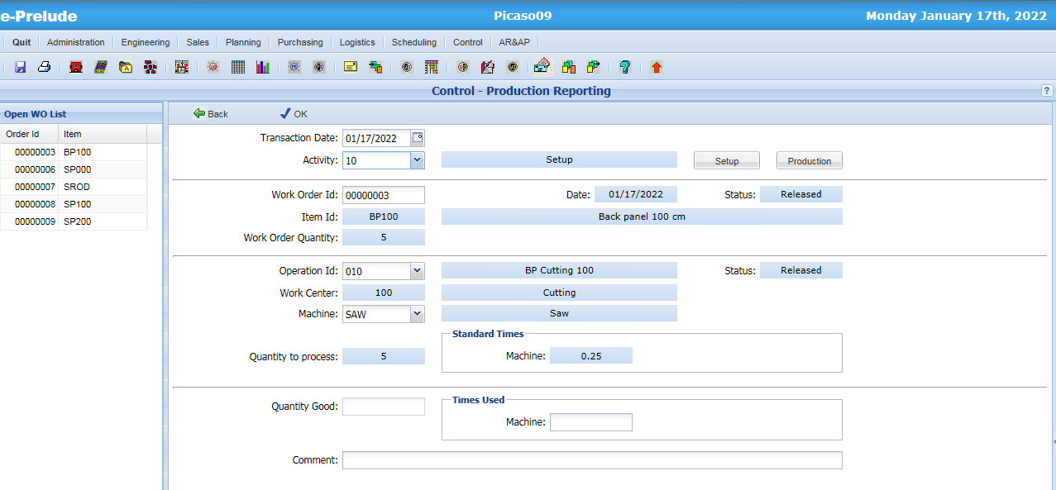
Production Reporting
Access: Control menu, Production Reporting option
Setup should be reported first
4. Validate
1- Enter the Activity
(Setup or Production)
2- Enter
quantity good
(if Production)
2. Back to Operation
3- Enter time used

Slide 24
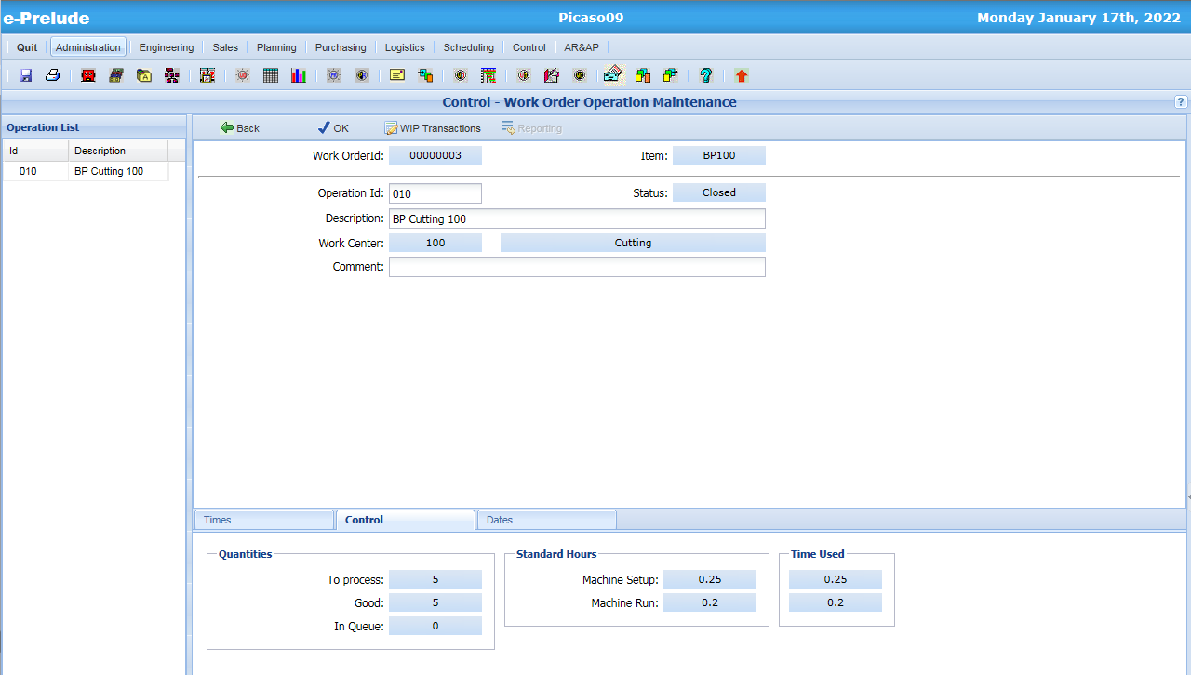
Work Order Operation
Access: Control menu, Open Work Order Maintenance option, Operations button
Operation is closed
Back to Work Order
Operation information is updated

Slide 25
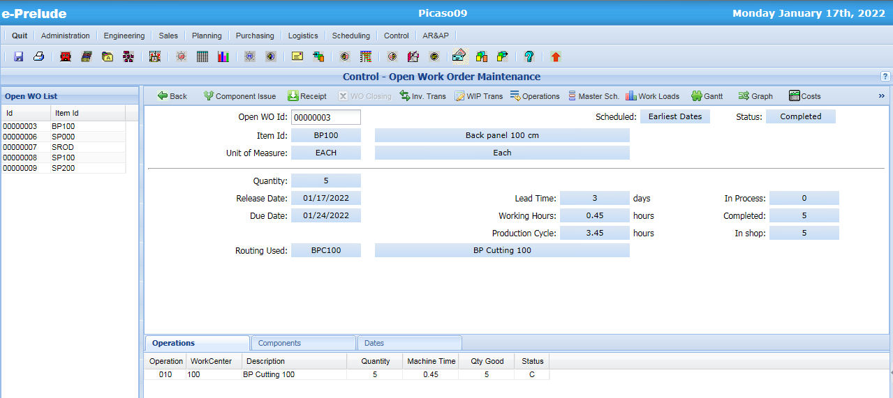
Work Order Completed
Access: Control menu, Open Work Order Maintenance option
Click on ‘Receipt’
Items in the shop

Slide 26
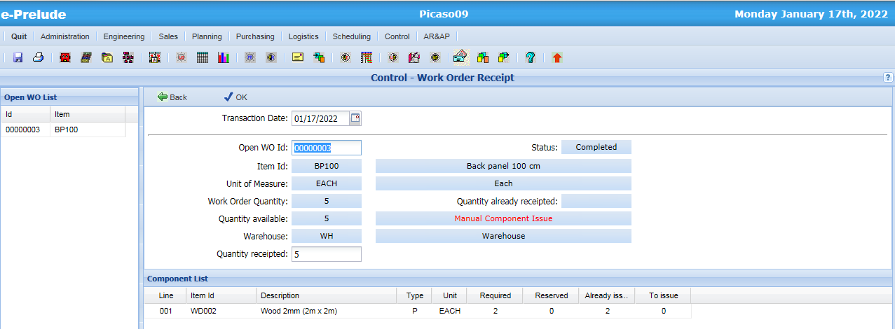
Completed WO Receipt into inventory
1- Validate
Receipt into inventory
2- Back to Work Order

Slide 27
Work order material tracking
The total quantity good at the last operation is the quantity completed on the work order
This quantity can be transferred into the warehouse
When the quantity receipted into the warehouse is equal to the quantity released, the Work Order can be closed

Slide 28
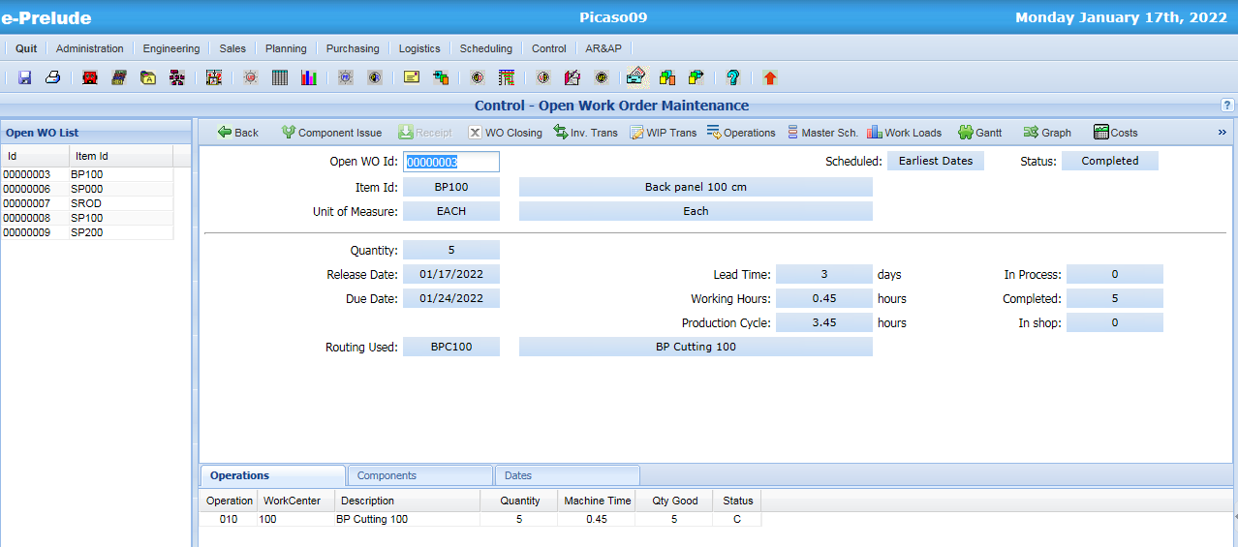
Work Order Closing
Click
to close the
Work Order

Slide 29
Summary of inventory transactions
Components
MRP
Available
Planned requirements
Planned to firm conversion
Firm requirements
Available
WO Release
Reserved for fabrication
Component Issue
Requirements in process
Product receipt
Manufactured product
Available

Slide 30
End of session 9

